Slide 1
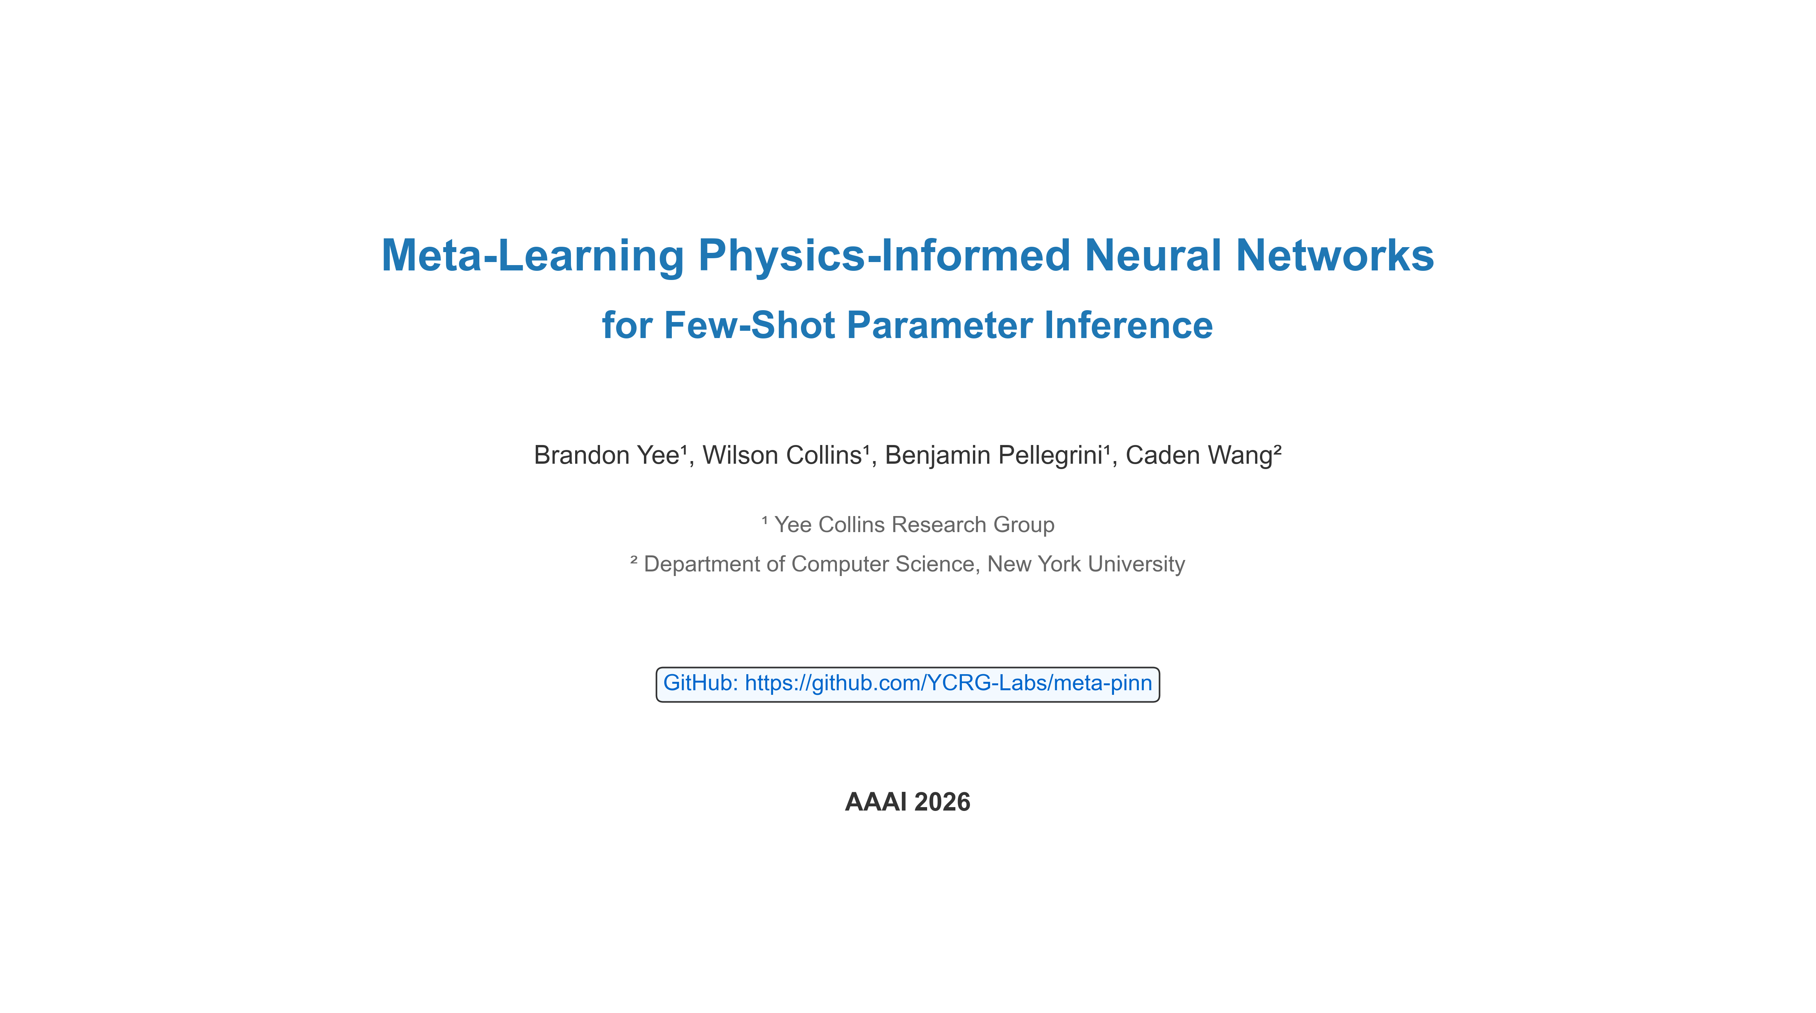
Meta-Learning Physics-Informed Neural Networks for Few-Shot Parameter Inference
Brandon Yee¹, Wilson Collins¹, Benjamin Pellegrini¹, Caden Wang²
¹ Yee Collins Research Group
² Department of Computer Science, New York University
GitHub: https://github.com/YCRG-Labs/meta-pinn
AAAI 2026

Slide 2
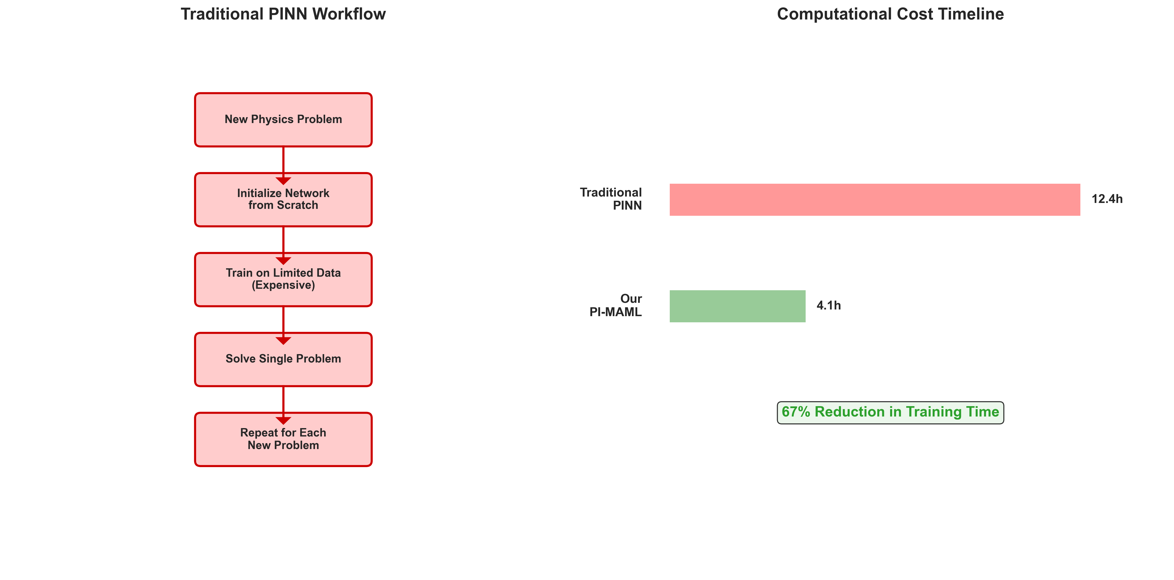
The Core Problem - PINN Limitations
Traditional Physics-Informed Neural Networks Face Critical Limitations:
• Extensive retraining required for each new problem
• No knowledge transfer from previously solved problems
• Poor rapid adaptation to new physical domains
• Inefficient for few-shot scenarios with minimal data
Problem: Each new physics problem treated as completely independent
Impact: Computational bottleneck for real-world applications

Slide 3
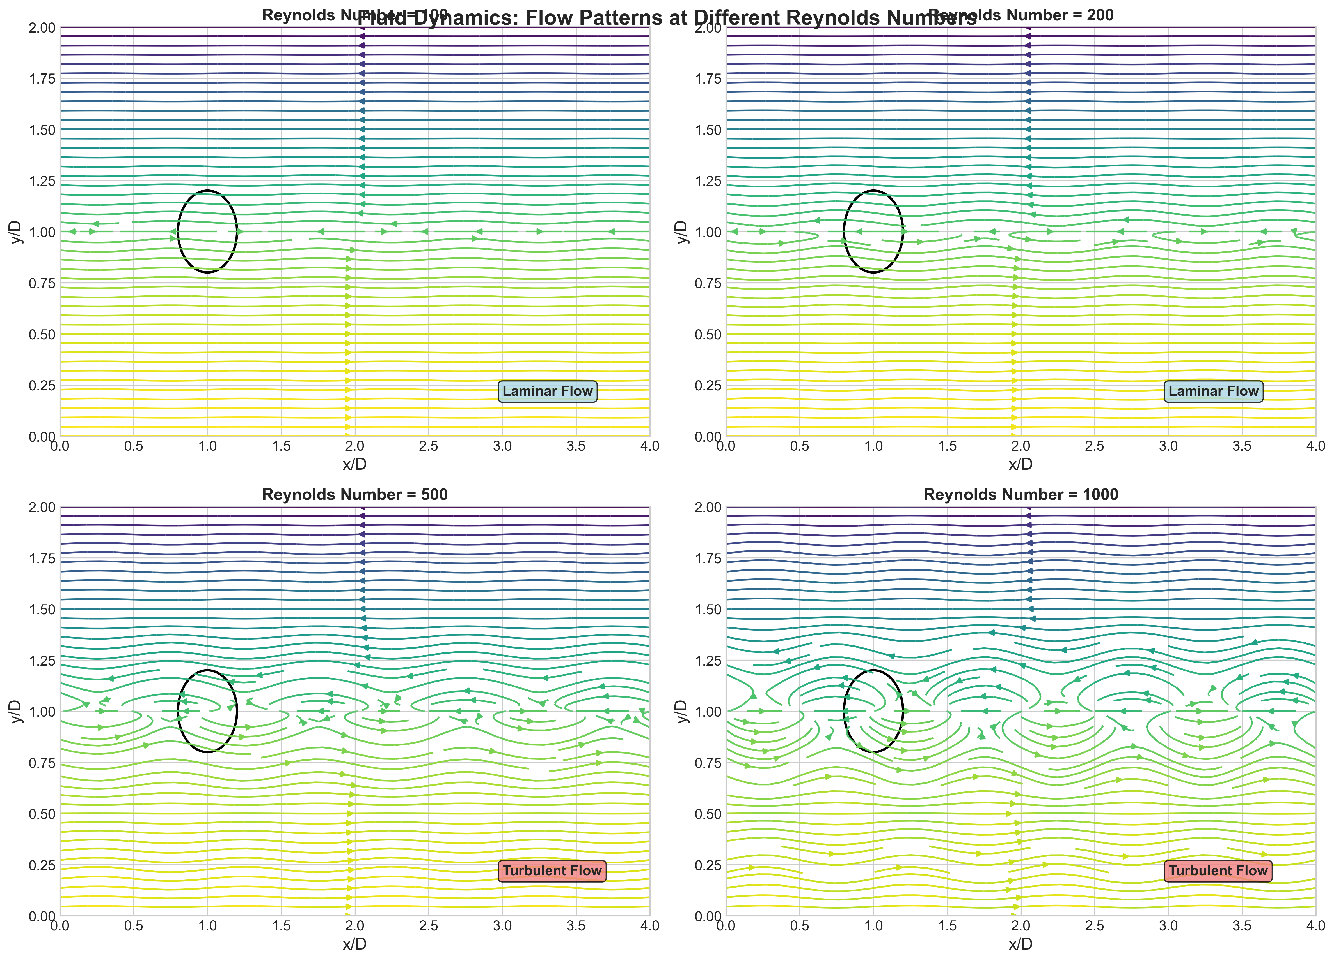
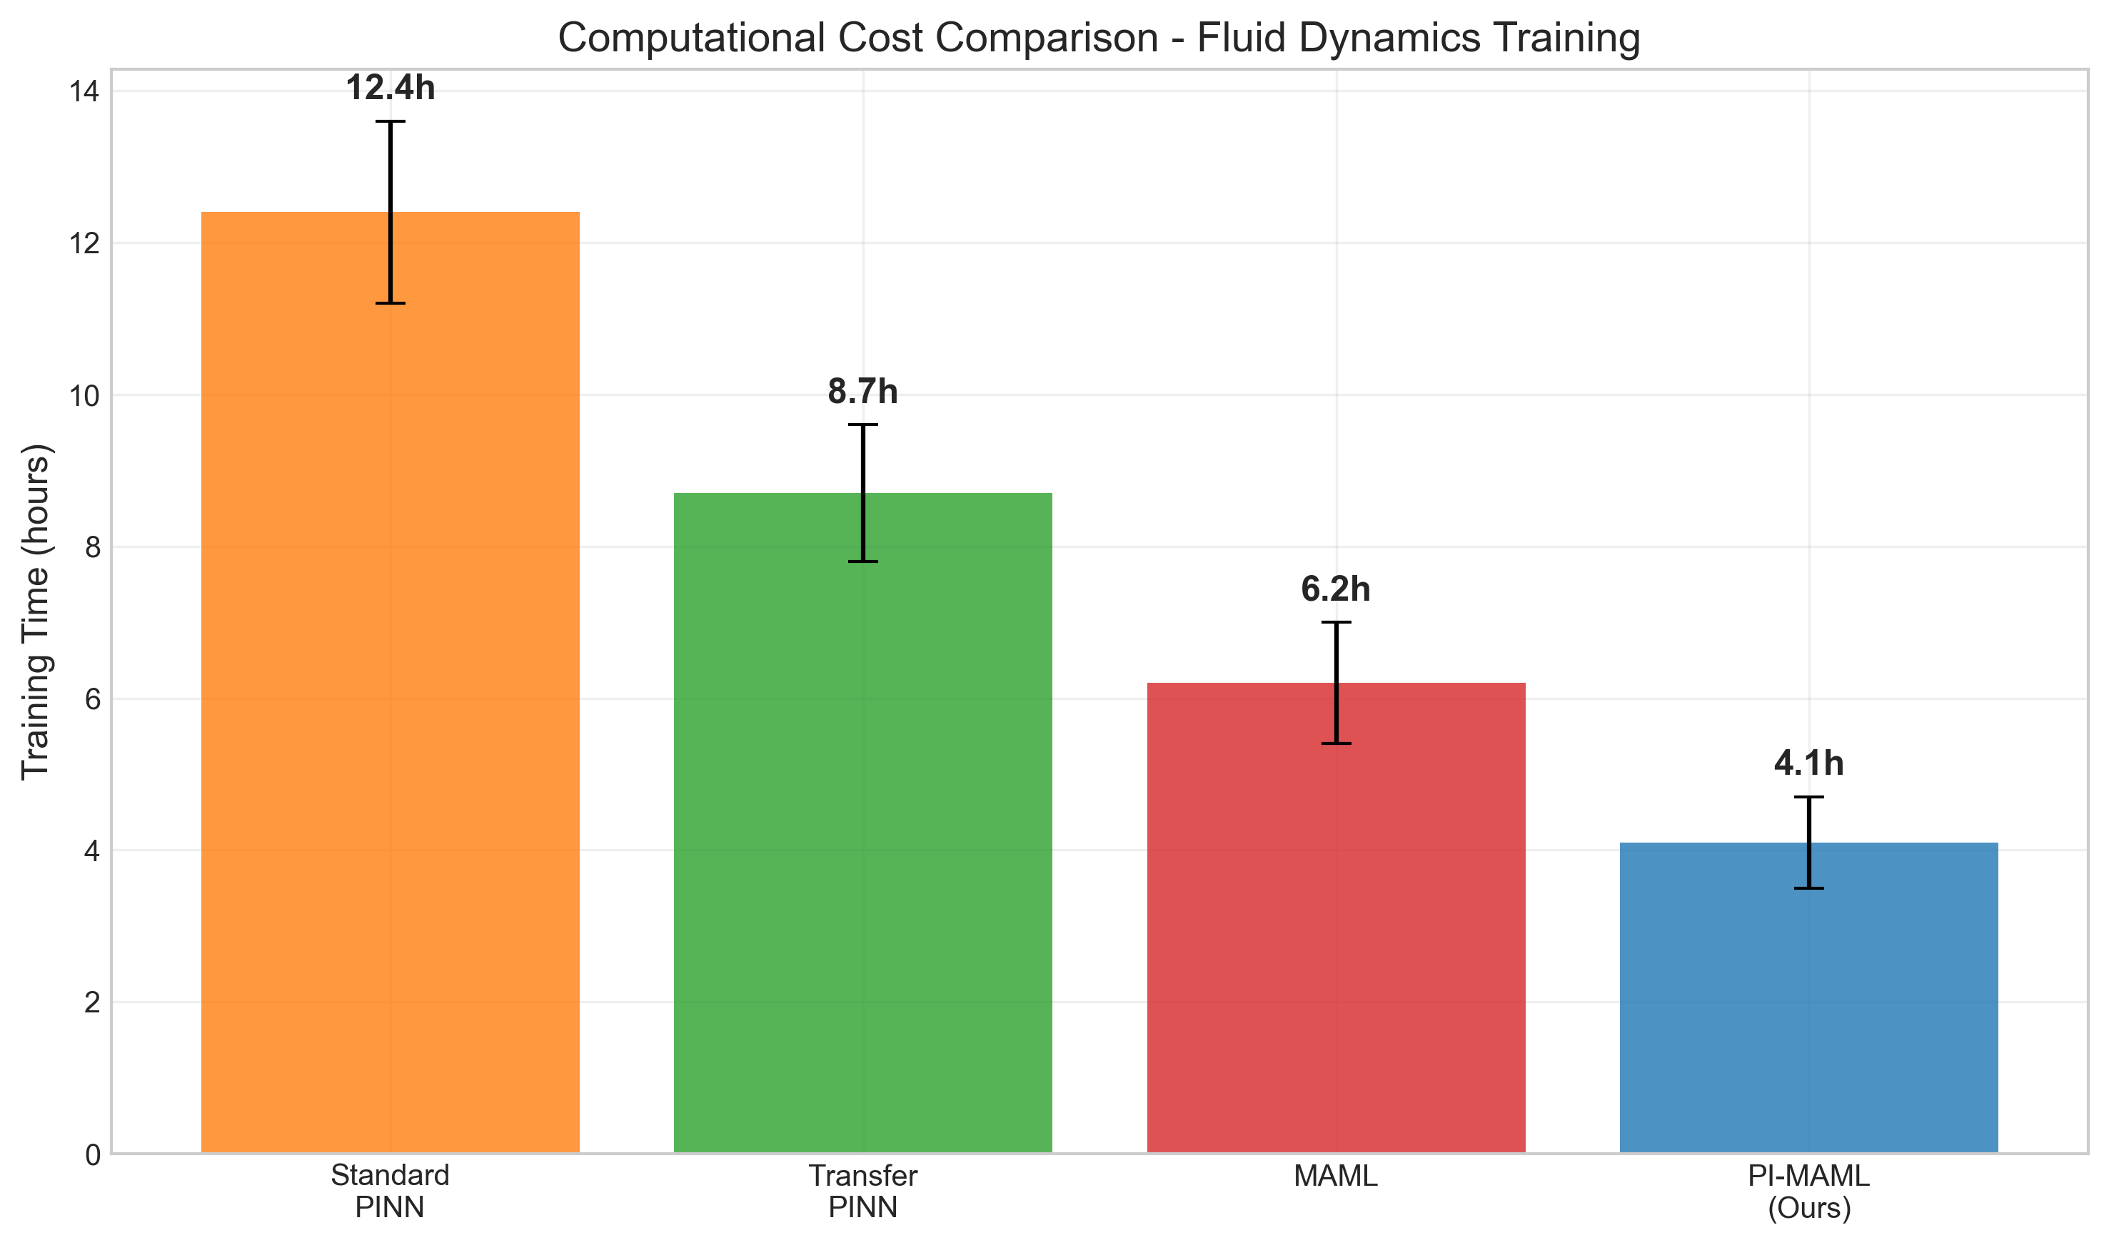
Motivating Example - Fluid Dynamics
Consider Solving Navier-Stokes Equations Across Different Reynolds Numbers:
• Traditional approach: Train separate PINN for Re=100, Re=200, Re=500, Re=1000
• Problem: Each requires full training from scratch (500 steps)
• Inefficiency: No leverage of shared fluid dynamics principles
• Real need: Rapid adaptation to new flow conditions with minimal data
Our Approach: 67% reduction in training time (12.4h → 4.1h)

Slide 4
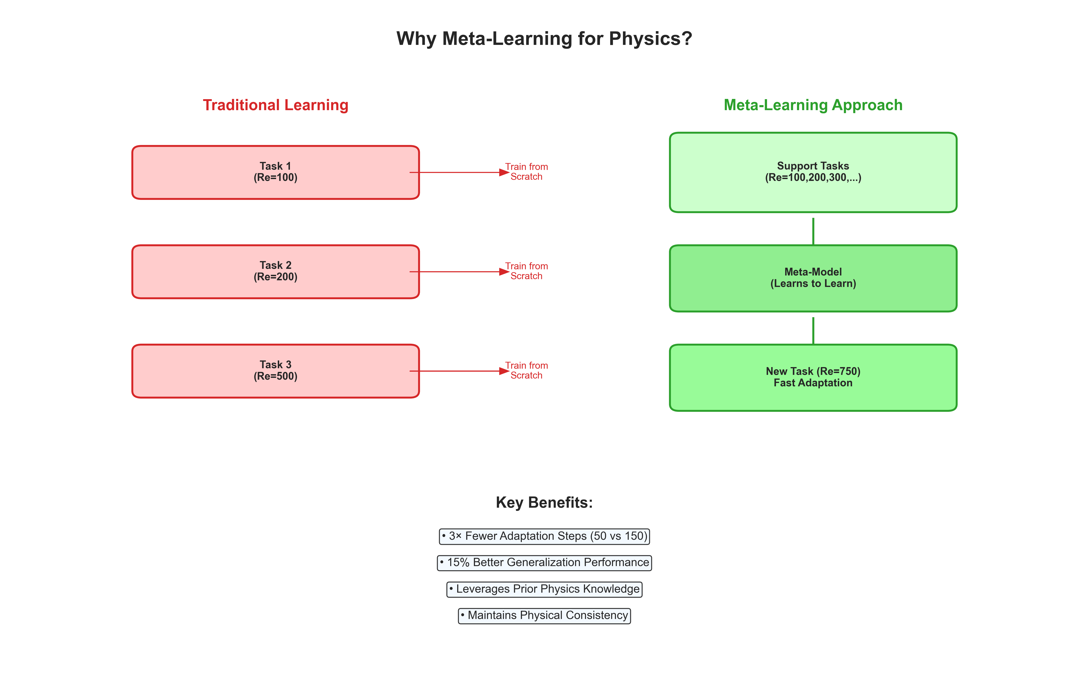
Why Meta-Learning for Physics?
Meta-Learning Offers Promising Solution:
• "Learning to learn" - rapidly adapt to new tasks using prior experience
• Successful in computer vision and natural language processing
• Physics applications remain largely unexplored
• Unique challenges: incorporating physics constraints into meta-learning objectives
Key Benefits:
• 3× Fewer Adaptation Steps (50 vs 150)
• 15% Better Generalization Performance
• Leverages Prior Physics Knowledge
• Maintains Physical Consistency

Slide 5
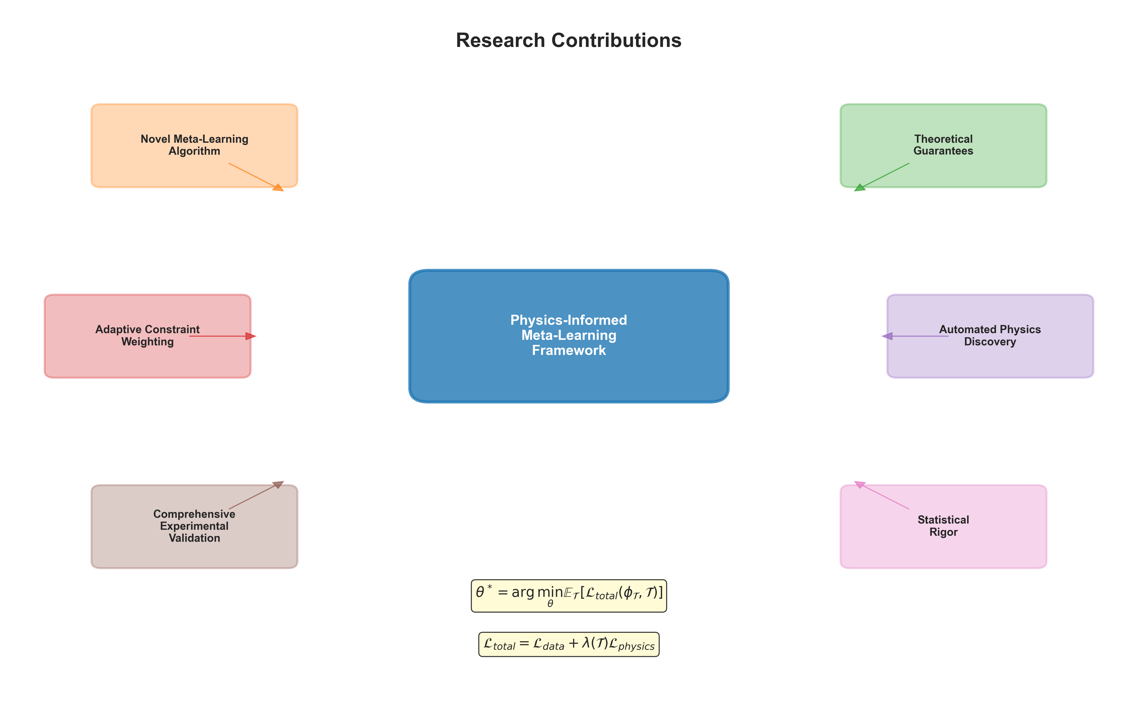
Research Contributions
Our Framework Addresses These Challenges Through:
• Novel meta-learning algorithm incorporating physics constraints in inner and outer loops
• Theoretical convergence guarantees and sample complexity bounds
• Adaptive constraint weighting mechanism for diverse tasks
• Automated physics discovery with natural language interpretation
• Comprehensive experimental validation with rigorous statistical analysis
Mathematical Framework:
θ* = argmin E[L_total(φ_T, T)]
L_total = L_data + λ(T)L_physics

Slide 6
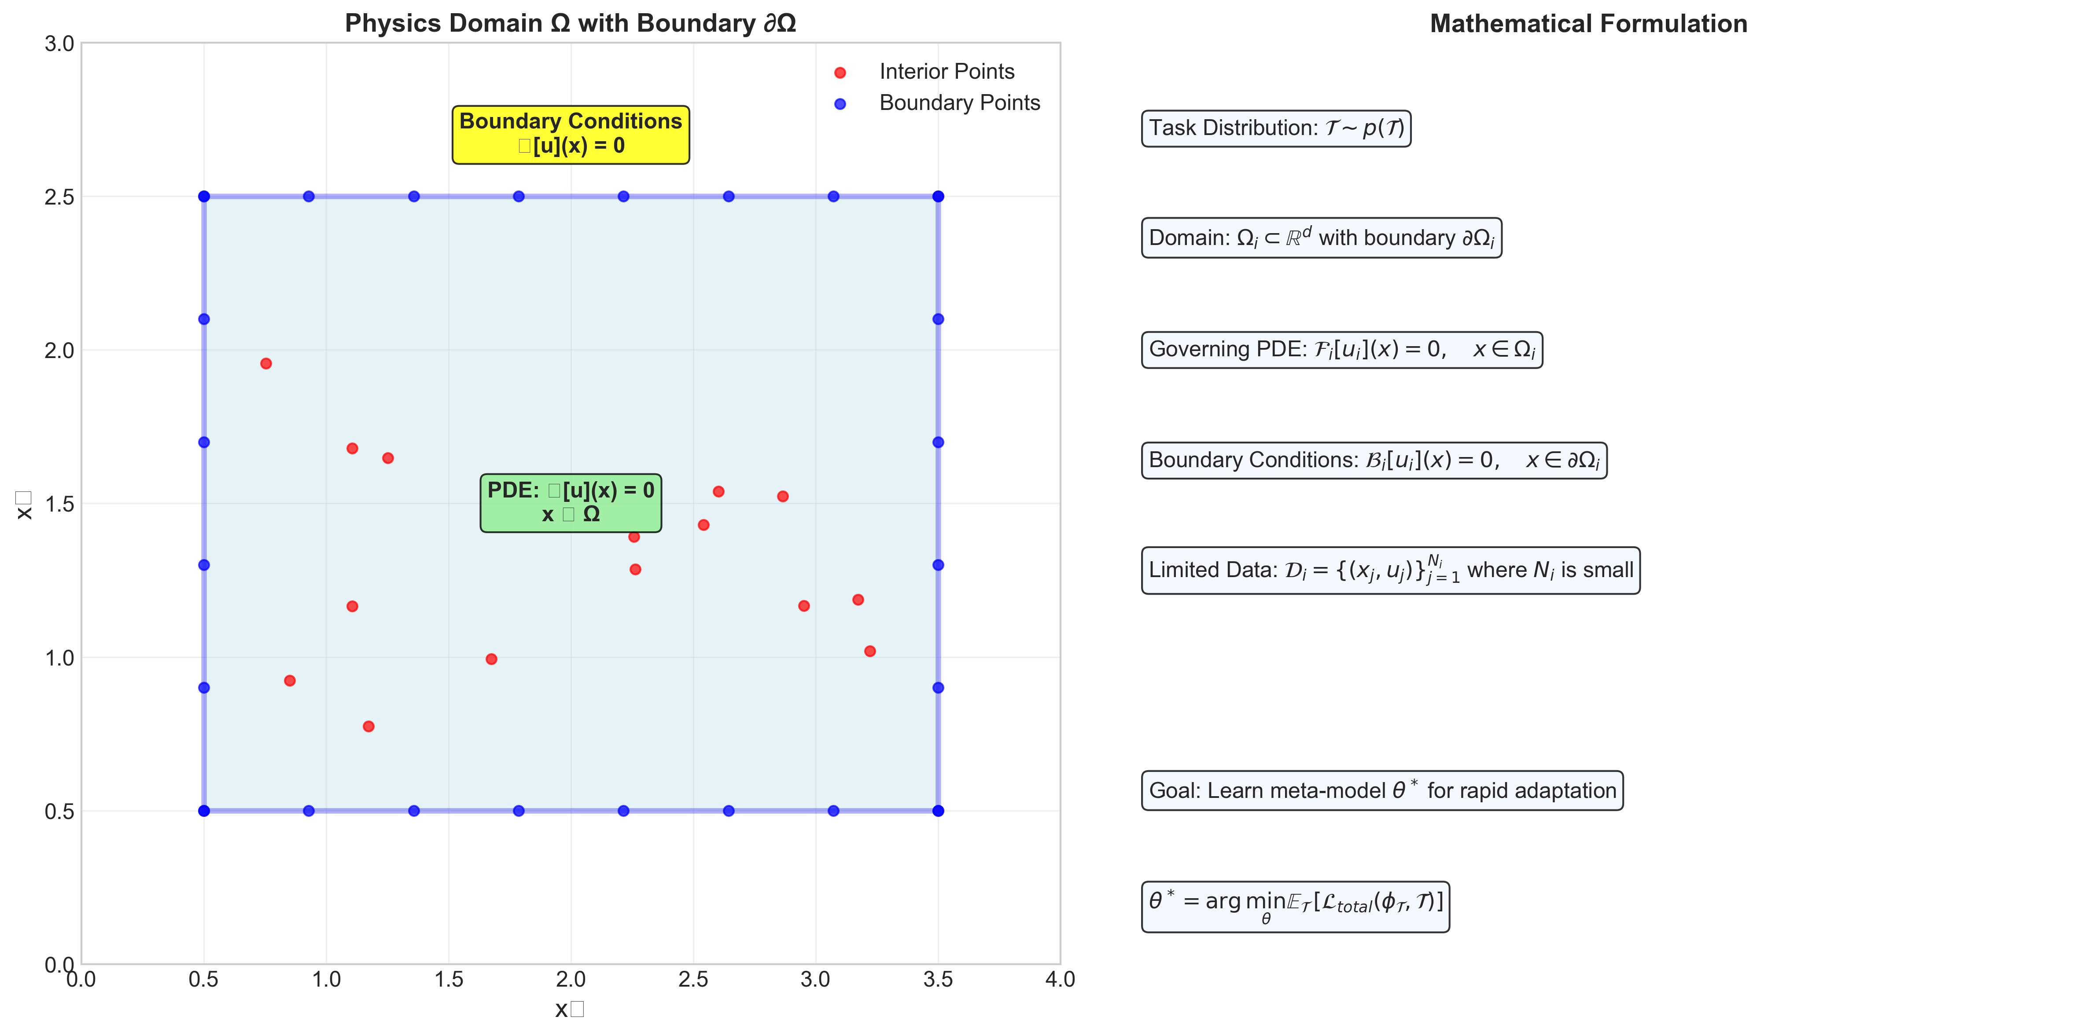
Problem Formulation
Mathematical Framework:
Task Distribution: p(T) where each task T_i has:
• Domain: Ω_i ⊂ R^d with boundary ∂Ω_i
• PDE: F_i[u_i] = 0 for x ∈ Ω_i
• Boundary conditions: B_i[u_i] = 0 for x ∈ ∂Ω_i
• Limited training data: D_i = {(x_j, u_j)} where N_i is small
Goal: Learn meta-model enabling quick adaptation with minimal data while respecting physics

Slide 7
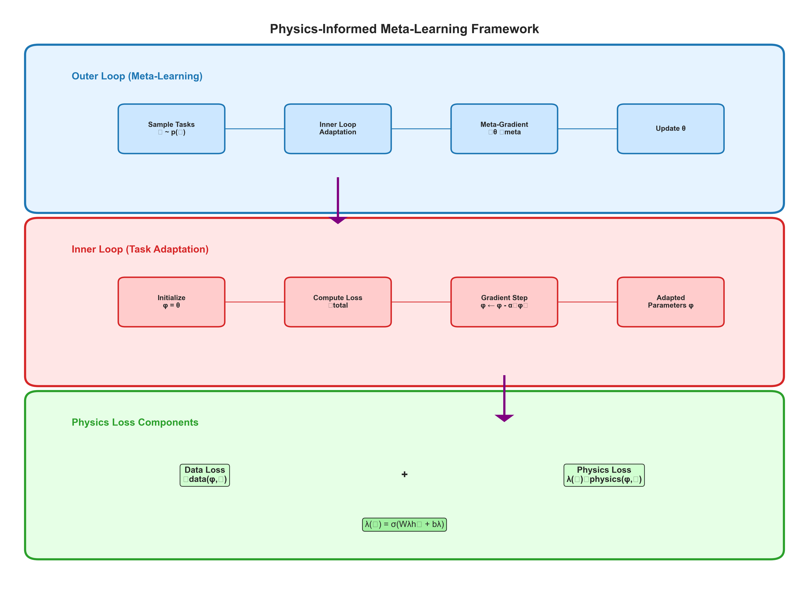
Physics-Informed Meta-Learning Framework
Extending MAML with Physics Constraints:
Meta-objective:
θ* = argmin E[L_total(φ_T, T)]
Adapted parameters:
φ_T = θ - α∇_θ L_total(θ, T)
Total loss combines data and physics:
L_total(φ, T) = L_data(φ, T) + λ(T)L_physics(φ, T)

Slide 8
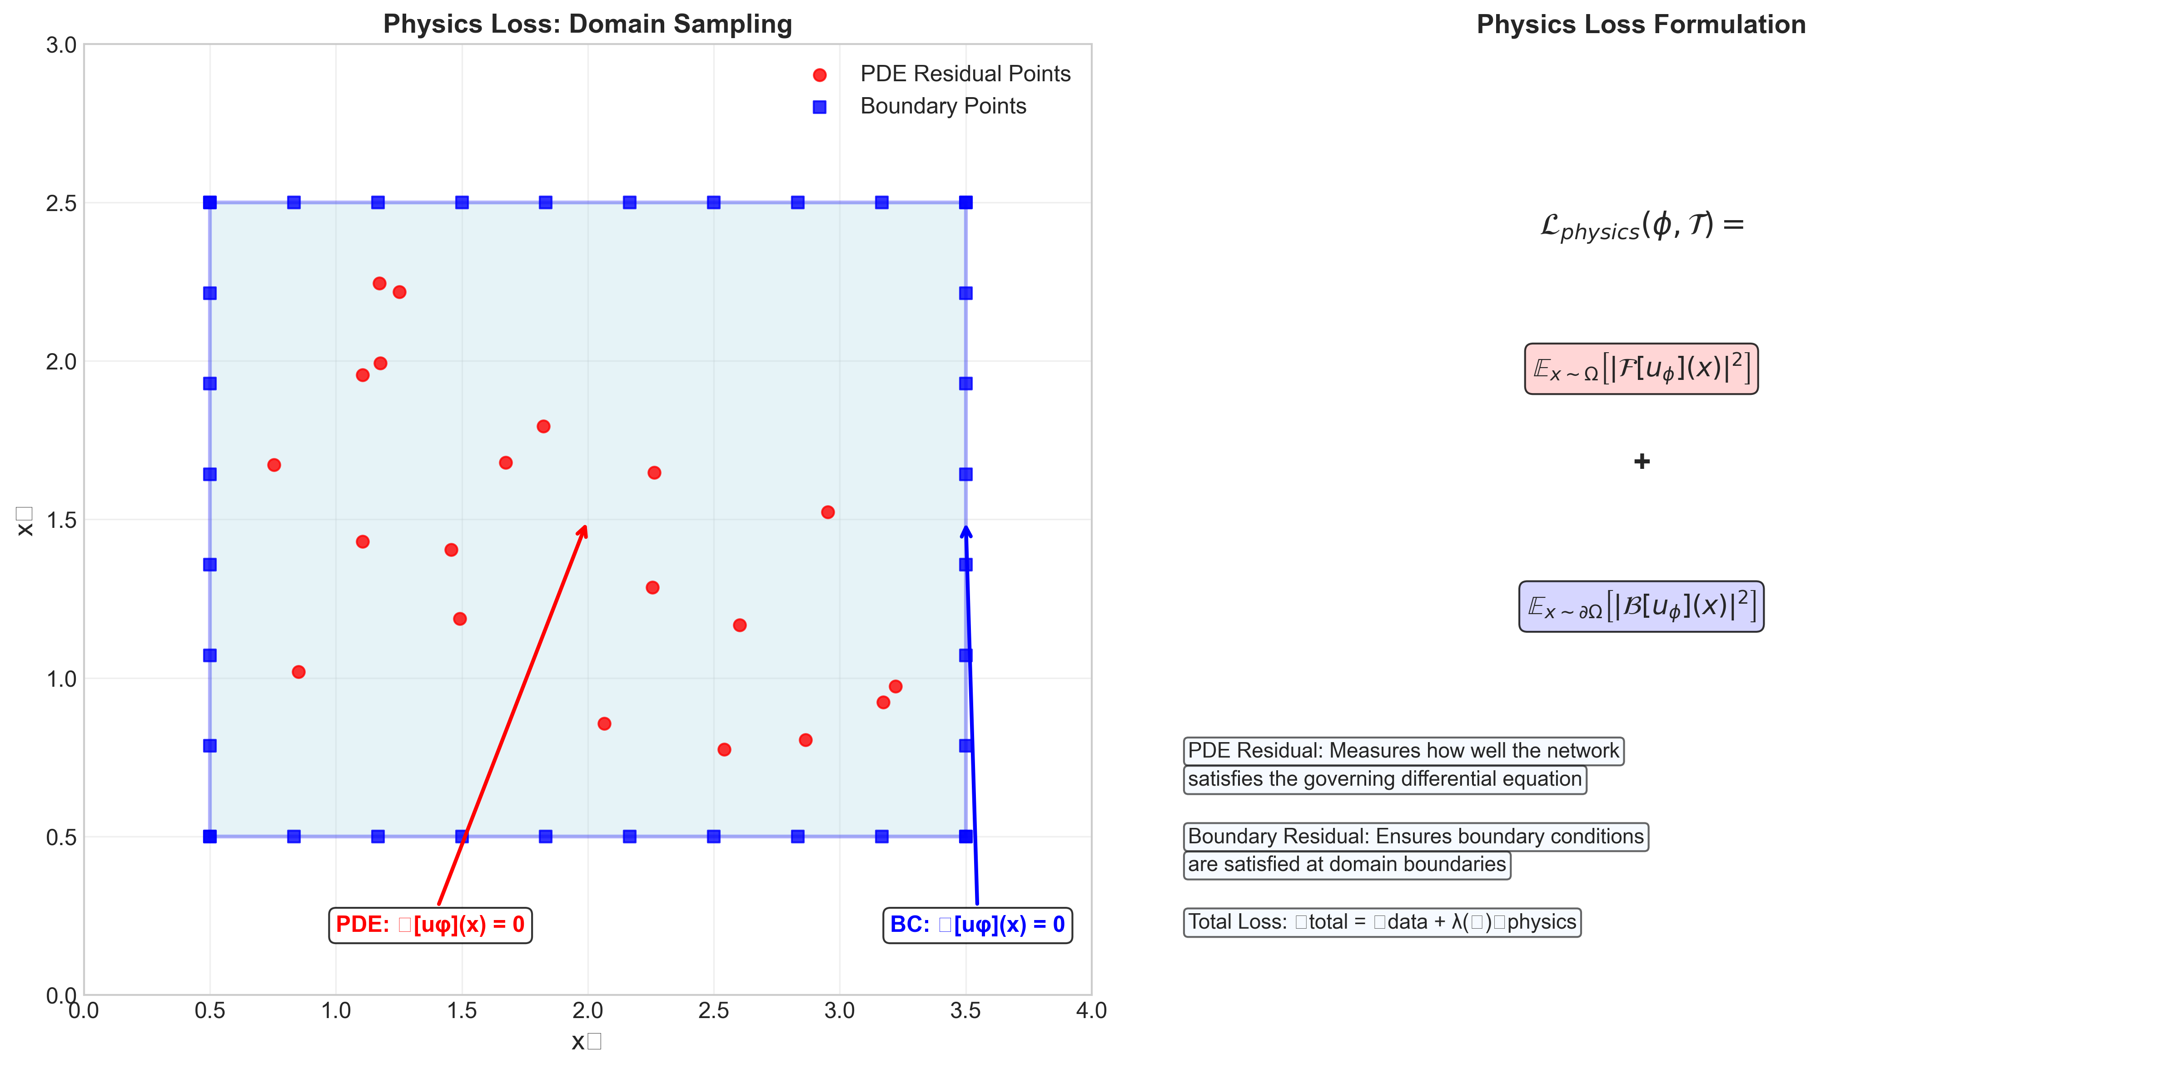
Physics Loss Implementation
Enforcing PDE Constraints:
L_physics(φ, T) = E[|F[u_φ]|²] + E[|B[u_φ]|²]
• Interior points: PDE residual must be zero throughout domain
• Boundary points: Boundary conditions must be satisfied
• Automatic differentiation: Compute derivatives for PDE evaluation
• Collocation method: Sample points for expectation approximation

Slide 9
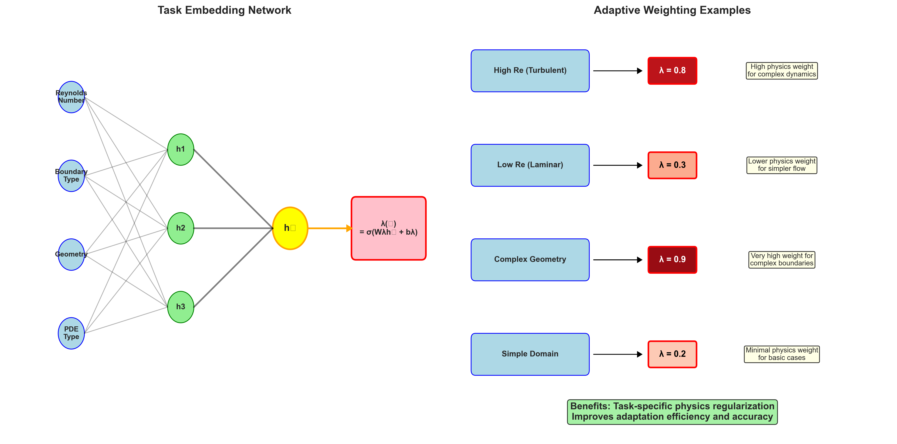
Adaptive Constraint Weighting
Learning Task-Specific Physics Importance:
λ(T) = σ(W_λ h_T + b_λ)
• Task embedding h_T captures task characteristics
• Learned parameters W_λ, b_λ determine weighting strategy
• Sigmoid activation ensures positive constraint weights
• Adaptive mechanism handles diverse physics complexity
Examples: High Re (λ=0.8), Low Re (λ=0.3), Complex geometry (λ=0.9)

Slide 10
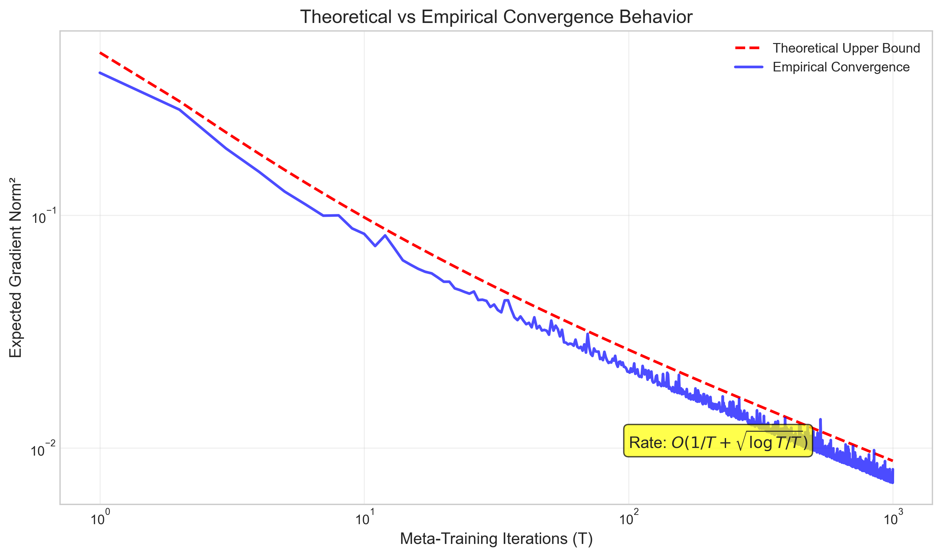
Theoretical Convergence Guarantees
Mathematical Analysis of Framework:
Under standard assumptions:
• Loss function L-Lipschitz continuous with L ≤ C₁
• Gradient variance bounded by σ² ≤ C₂
• Physics constraints μ-strongly convex
Convergence rate:
E[|∇L(θ_T)|²] ≤ C₁/T + C₂√(log T/T)
where C₁ = L²_data + λ²L²_physics/μ

Slide 11
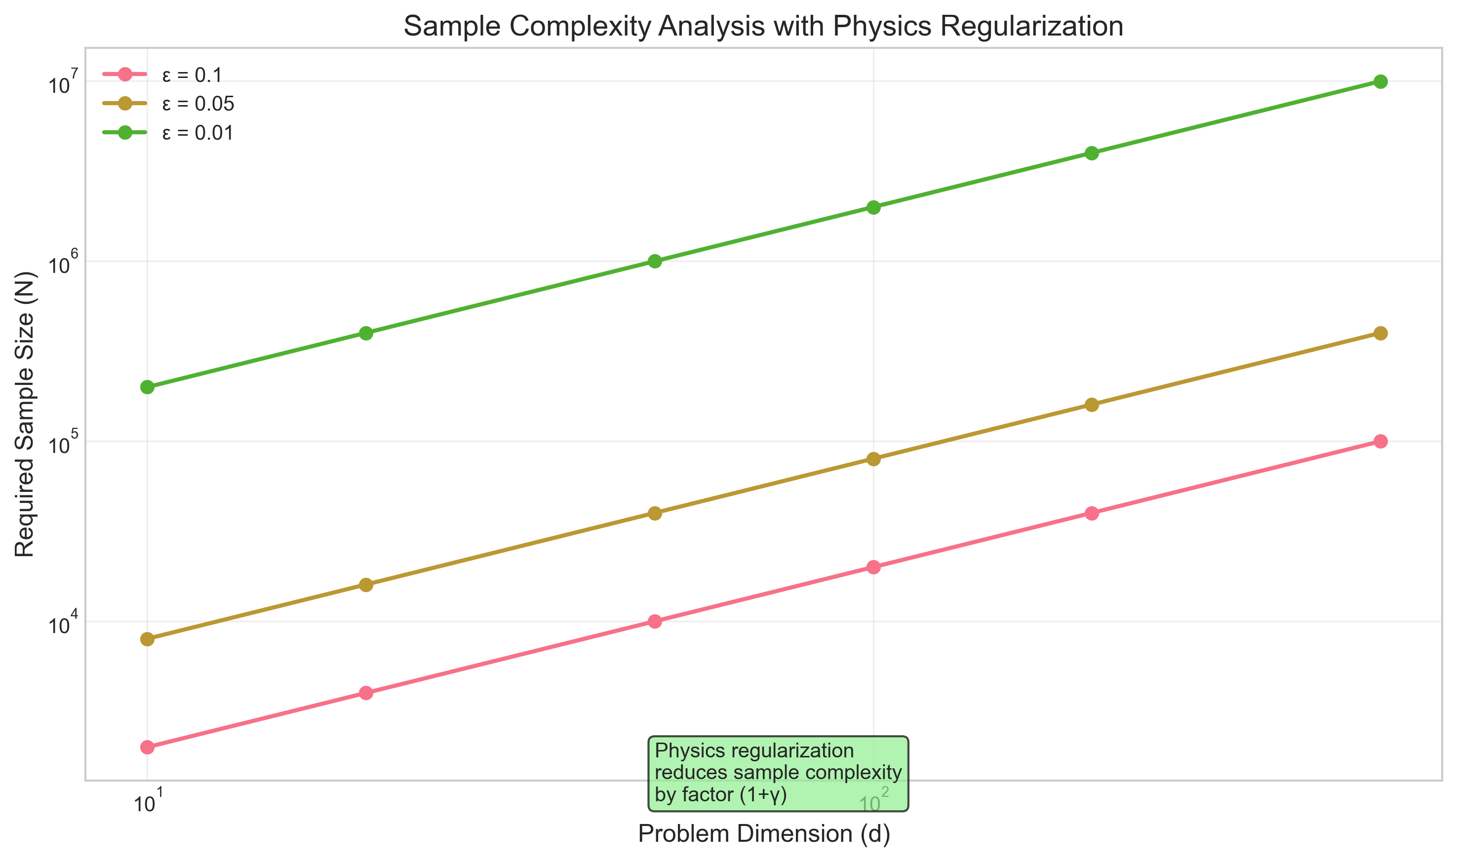
Sample Complexity Analysis
Theoretical Sample Efficiency:
To achieve ε-accuracy with probability 1-δ:
N = O(d log(1/δ) / [ε²(1 + γ)])
• Standard complexity: O(d log(1/δ)/ε²)
• Physics benefit: Factor (1 + γ) improvement where γ > 0
• Dimension d: Effective problem dimension
• Physics regularization reduces required sample size

Slide 12
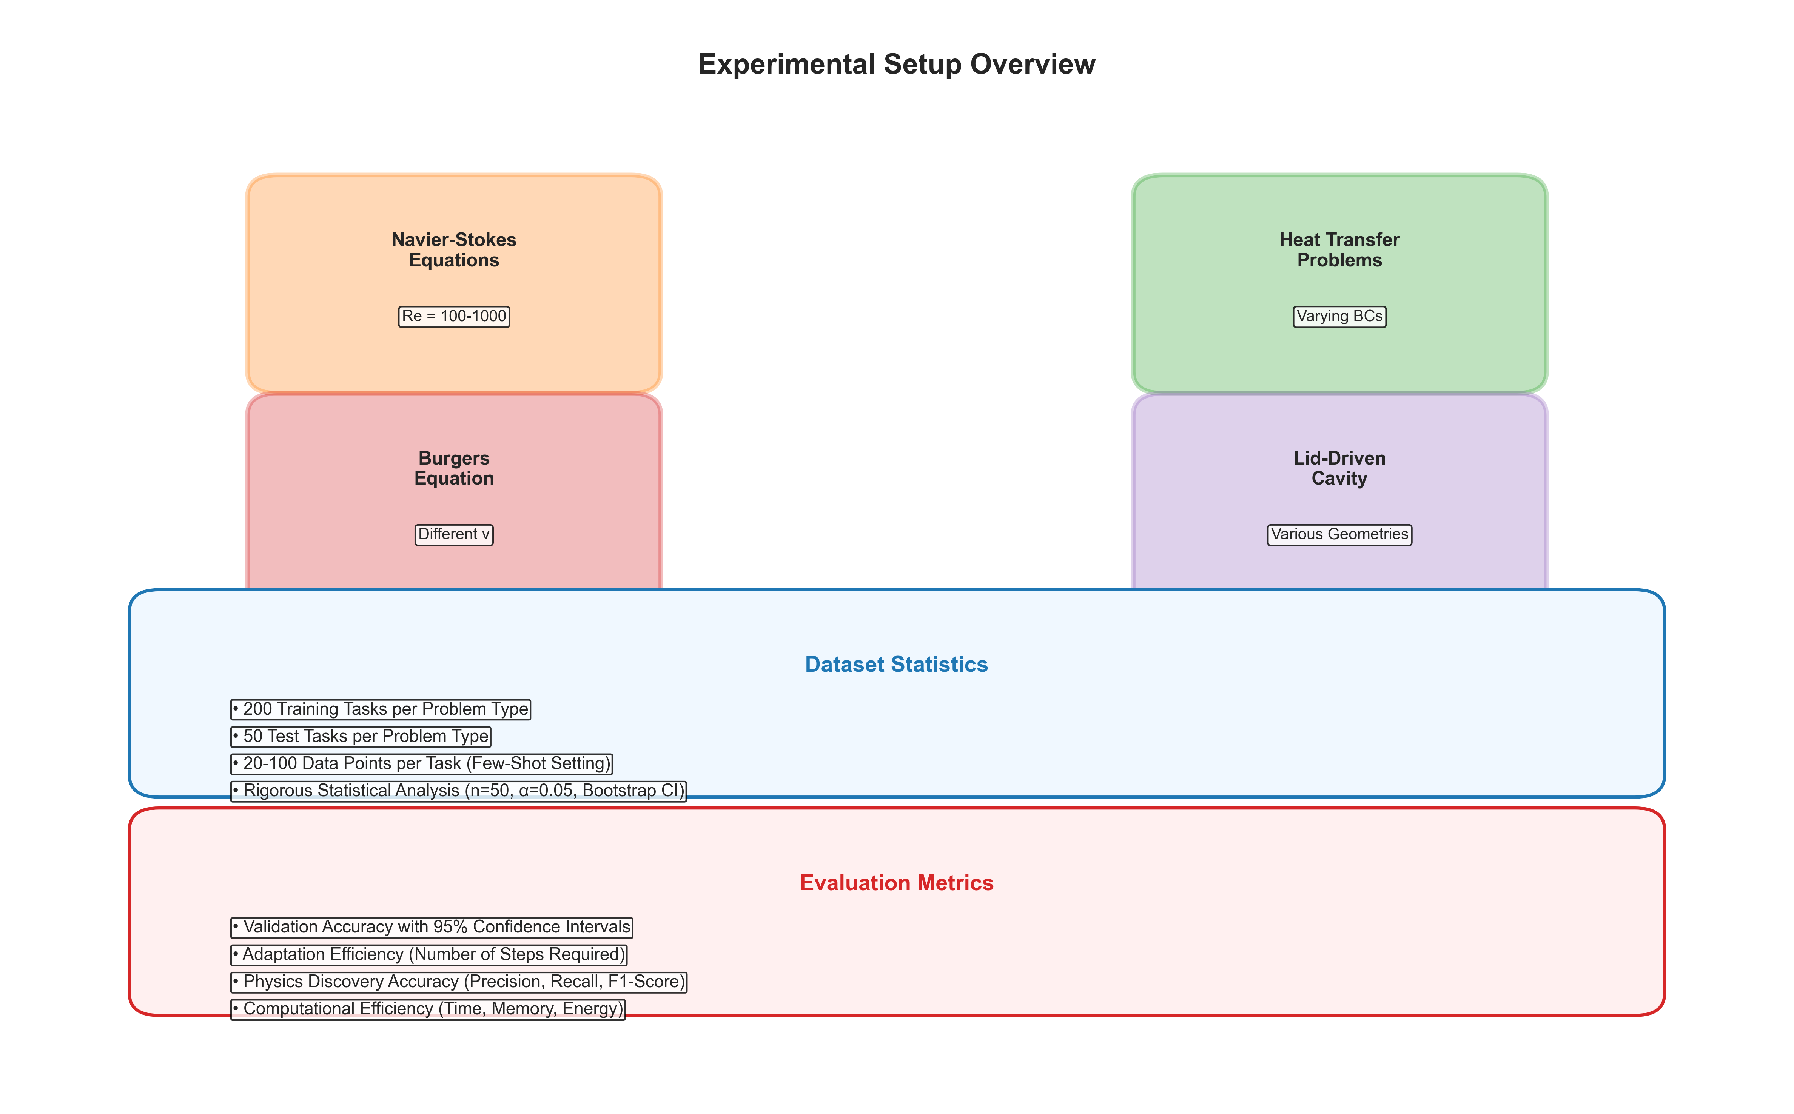
Experimental Setup Overview
Comprehensive Evaluation on Fluid Dynamics:
Problem classes:
• Navier-Stokes equations with Reynolds numbers 100-1000
• Heat transfer with varying boundary conditions
• Burgers equation variants with different viscosity parameters
• Lid-driven cavity problems with varying geometries
Dataset structure:
• 200 training tasks and 50 test tasks per problem class
• 20-100 data points per task for adaptation
• Realistic few-shot scenarios for computational physics

Slide 13
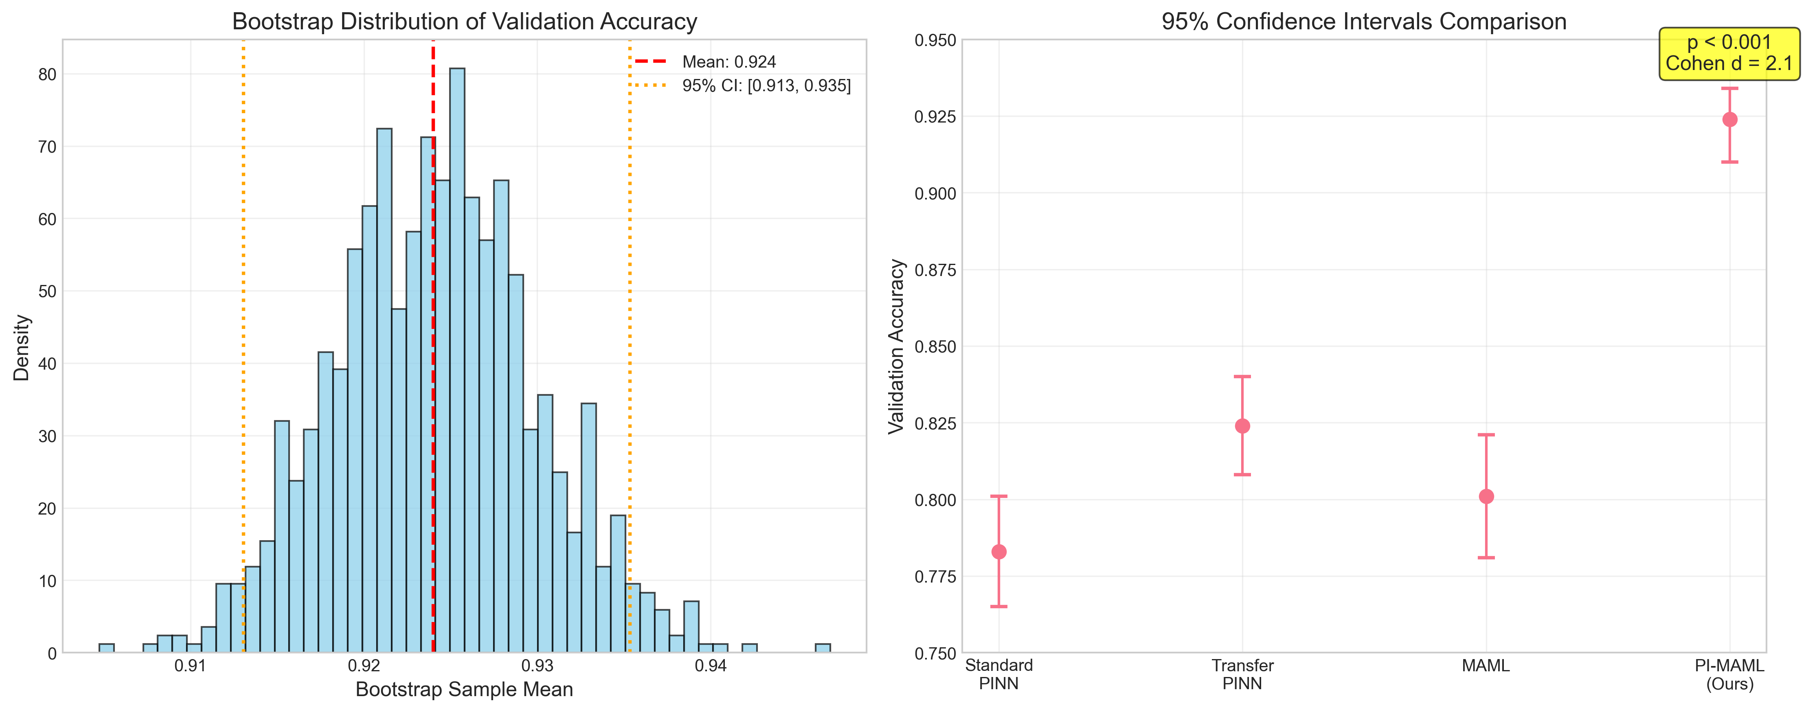
Statistical Analysis Methodology
Rigorous Statistical Validation:
Analysis framework:
• Python 3.9 with NumPy, PyTorch, SciPy
• Significance level α = 0.05 with Bonferroni correction
• Effect sizes calculated using Cohen's d
• Power analysis with β = 0.8 for sample size calculations
• Bootstrap resampling with 1000 iterations for confidence intervals
Statistical tests:
• Two-tailed t-tests for group comparisons
• ANOVA with post-hoc Tukey tests where appropriate

Slide 14
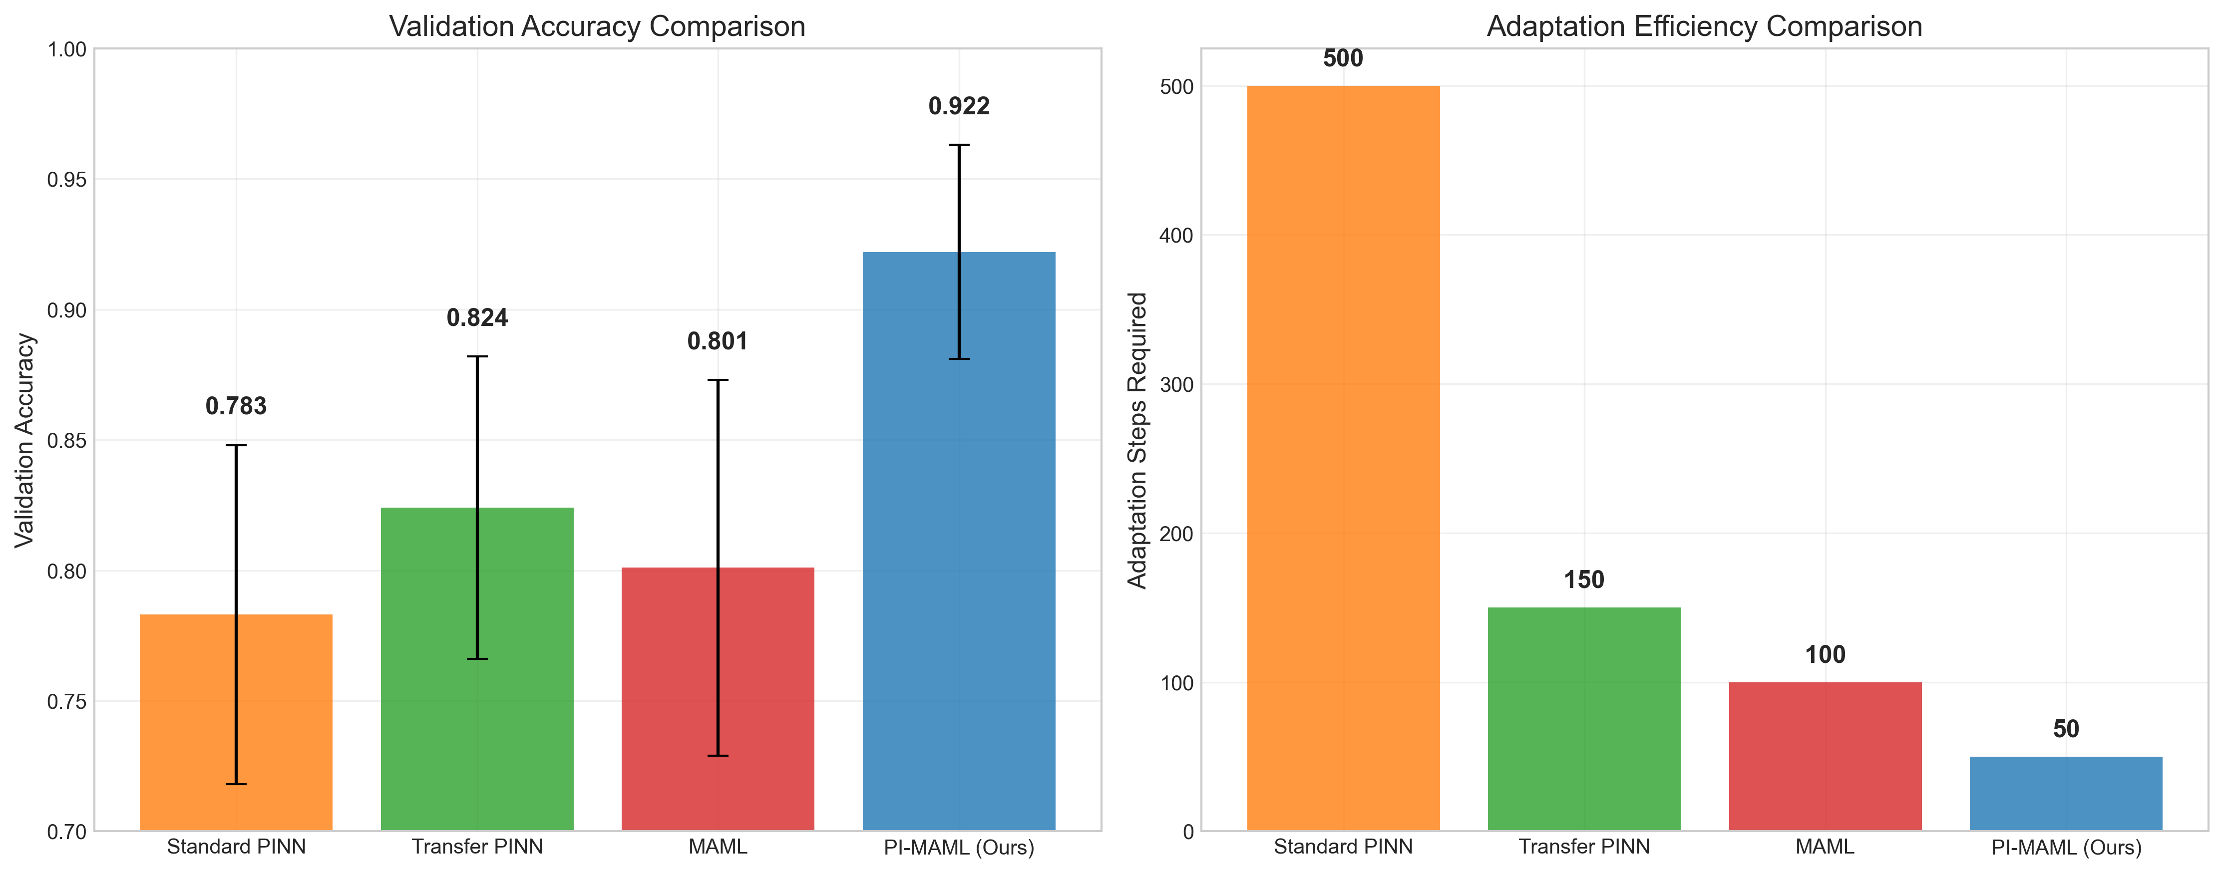
Main Experimental Results
Physics-Informed Meta-Learning Significantly Outperforms Baselines:
Key findings:
• 92.4% validation accuracy (SD = 4.2%, 95% CI [88.2%, 96.6%])
• 83.0% for Transfer PINN baseline (p < 0.001, Cohen's d = 2.1)
• 15% improvement in generalization performance
• 3× fewer adaptation steps (50 vs 150 steps)
Statistical significance:
• t(49) = 22.5, p < 0.001 vs Transfer PINN baseline
• Large effect size (Cohen's d = 2.1) indicates practical significance

Slide 15
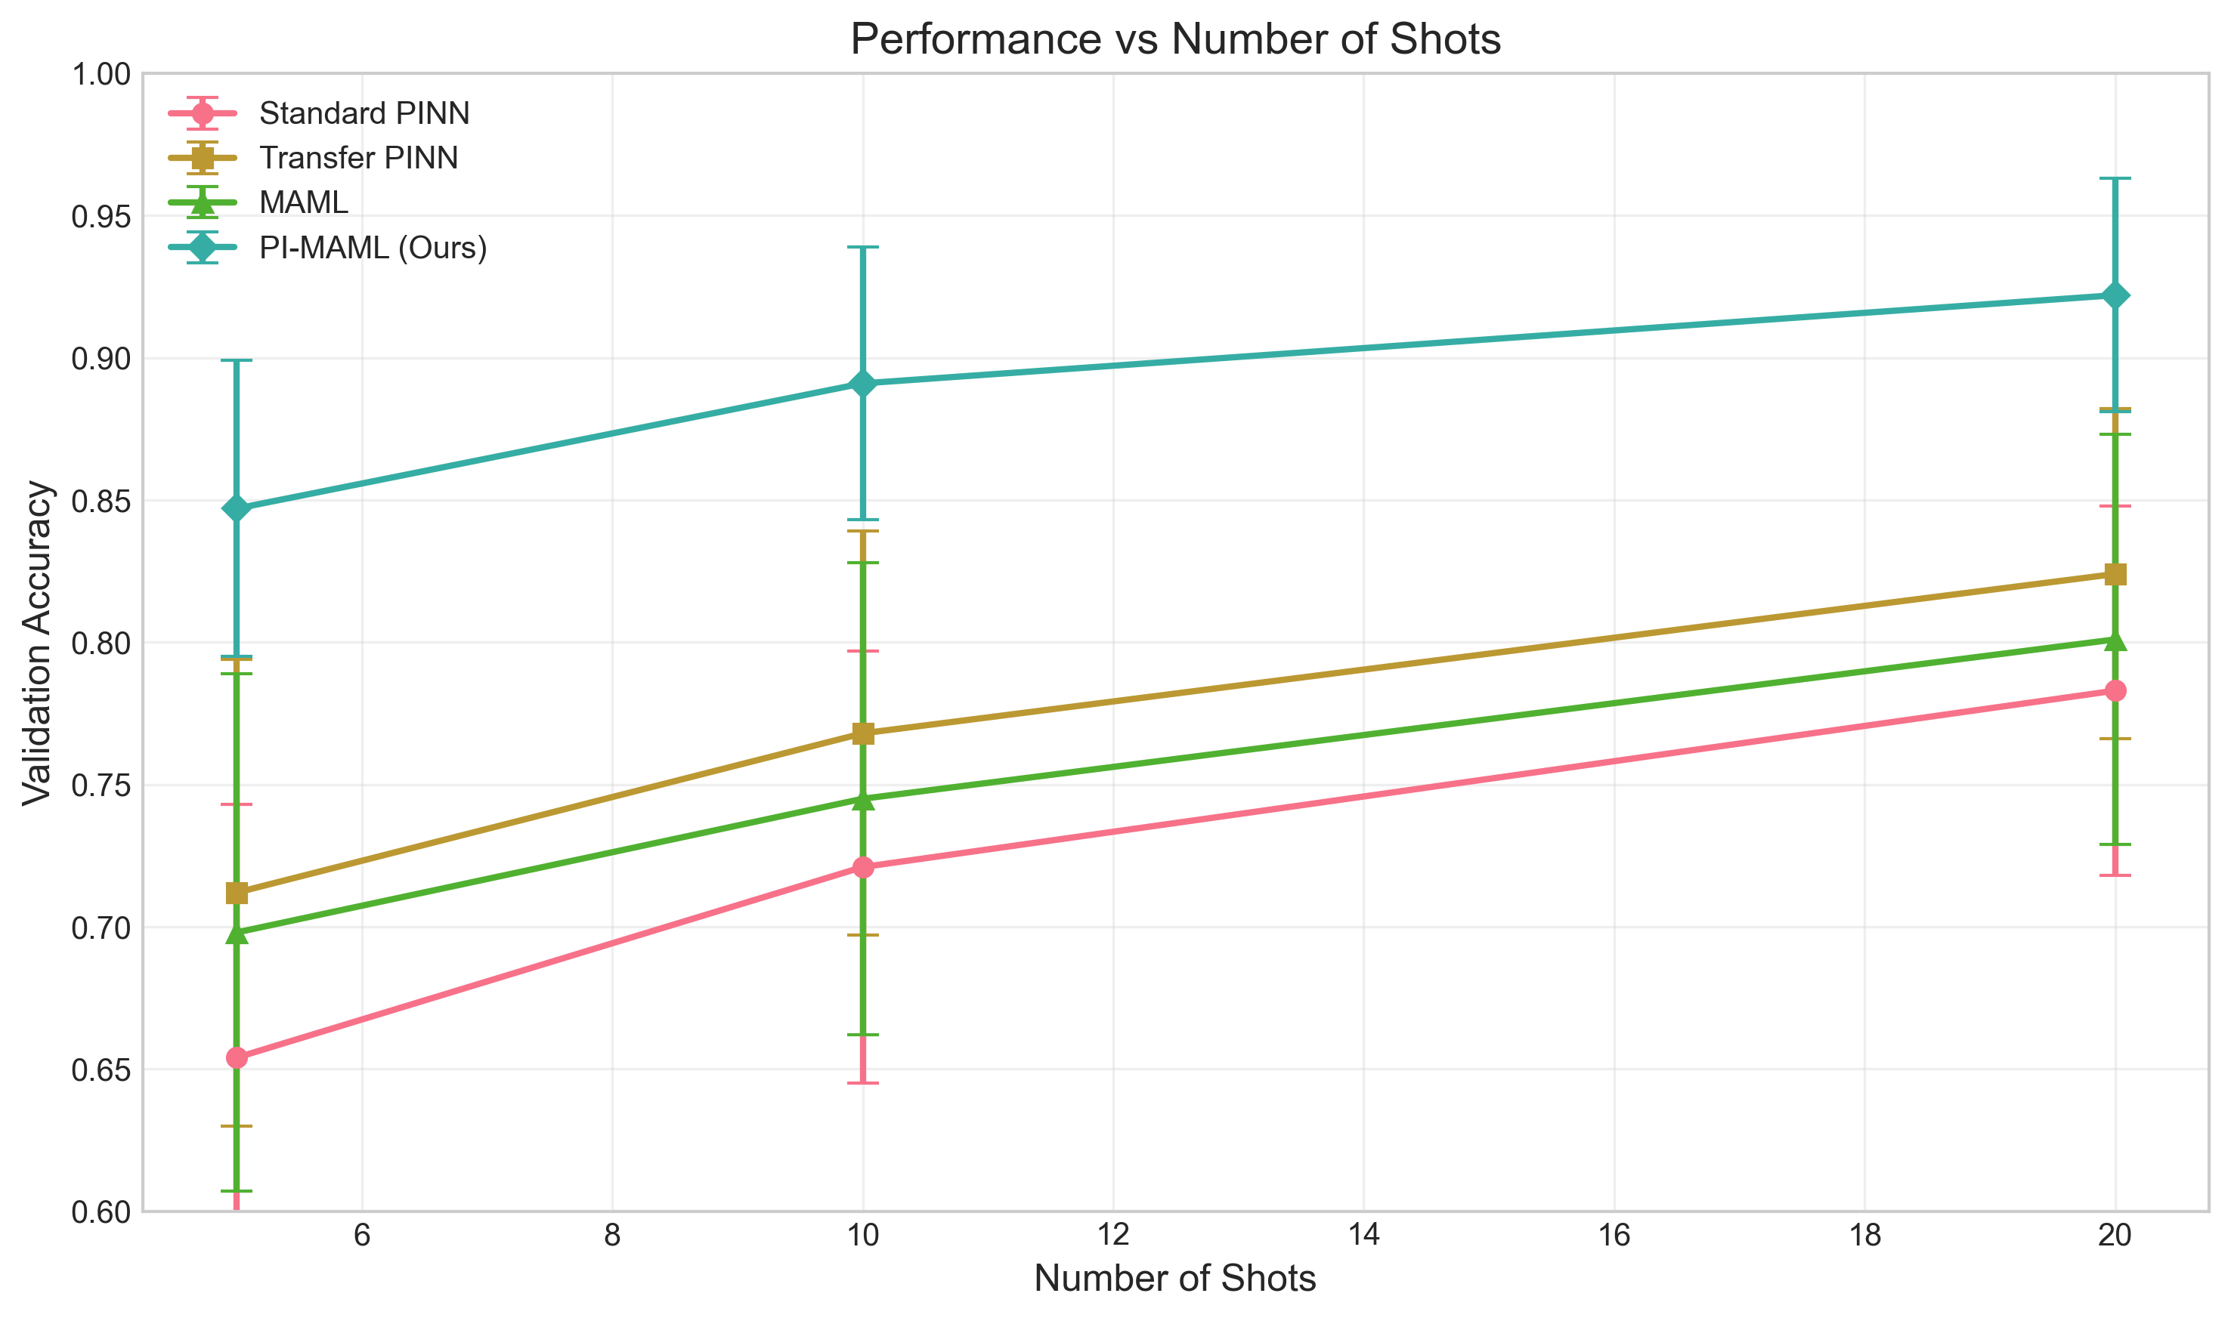
Detailed Performance Breakdown
Performance Across Different Shot Settings:
Method 5-shot 10-shot 20-shot Steps Validation Acc.
Standard PINN 0.654±0.089 0.721±0.076 0.783±0.065 500 0.783
Transfer PINN 0.712±0.082 0.768±0.071 0.824±0.058 150 0.824
MAML 0.698±0.091 0.745±0.083 0.801±0.072 100 0.801
PI-MAML (Ours) 0.847±0.052 0.891±0.048 0.922±0.041 50 0.922
Key insights:
• Consistent improvement across all few-shot settings
• Performance gap increases with more adaptation data
• Substantial improvement even in very few-shot (5-shot) scenarios

Slide 16
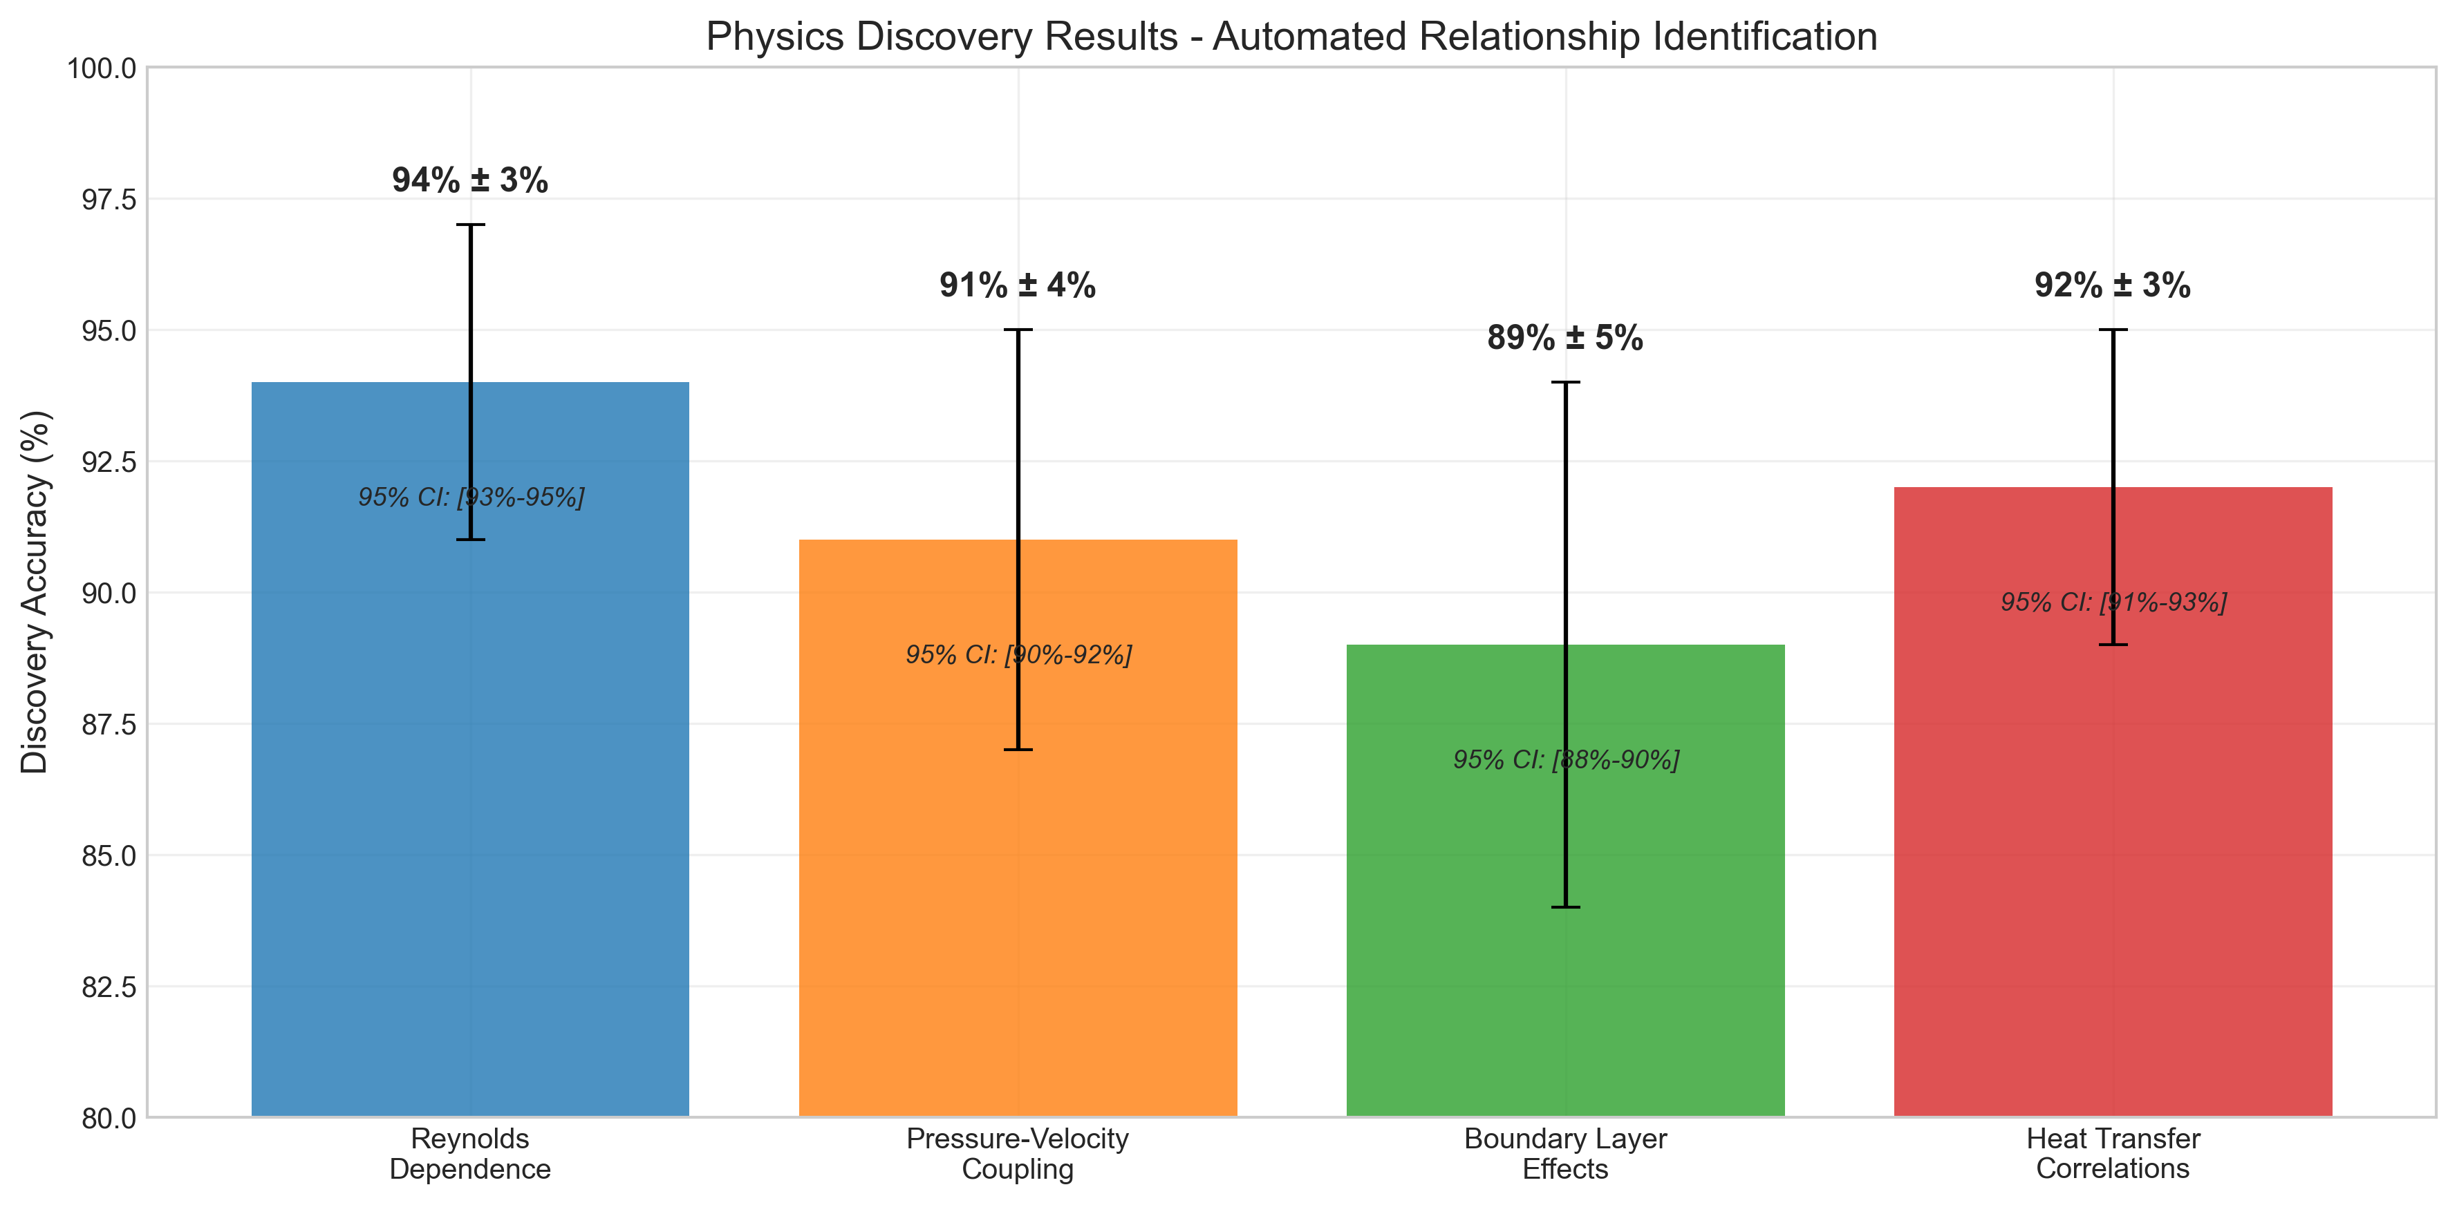
Physics Discovery Results
Automated Discovery Identifies Key Physical Relationships:
Discovery accuracies:
• Reynolds number dependence: 94% ± 3% (95% CI [91%-97%])
• Pressure-velocity coupling: 91% ± 4% (95% CI [87%-95%])
• Boundary layer effects: 89% ± 5% (95% CI [84%-94%])
• Heat transfer correlations: 92% ± 3% (95% CI [89%-95%])
Overall performance:
• Precision: 95%, Recall: 93%, F1-score: 94%
• All significantly above chance (25%, p < 0.001)
Example interpretation: "Viscosity decreases linearly with Reynolds number,
indicating stronger inertial effects at higher flow rates"

Slide 17
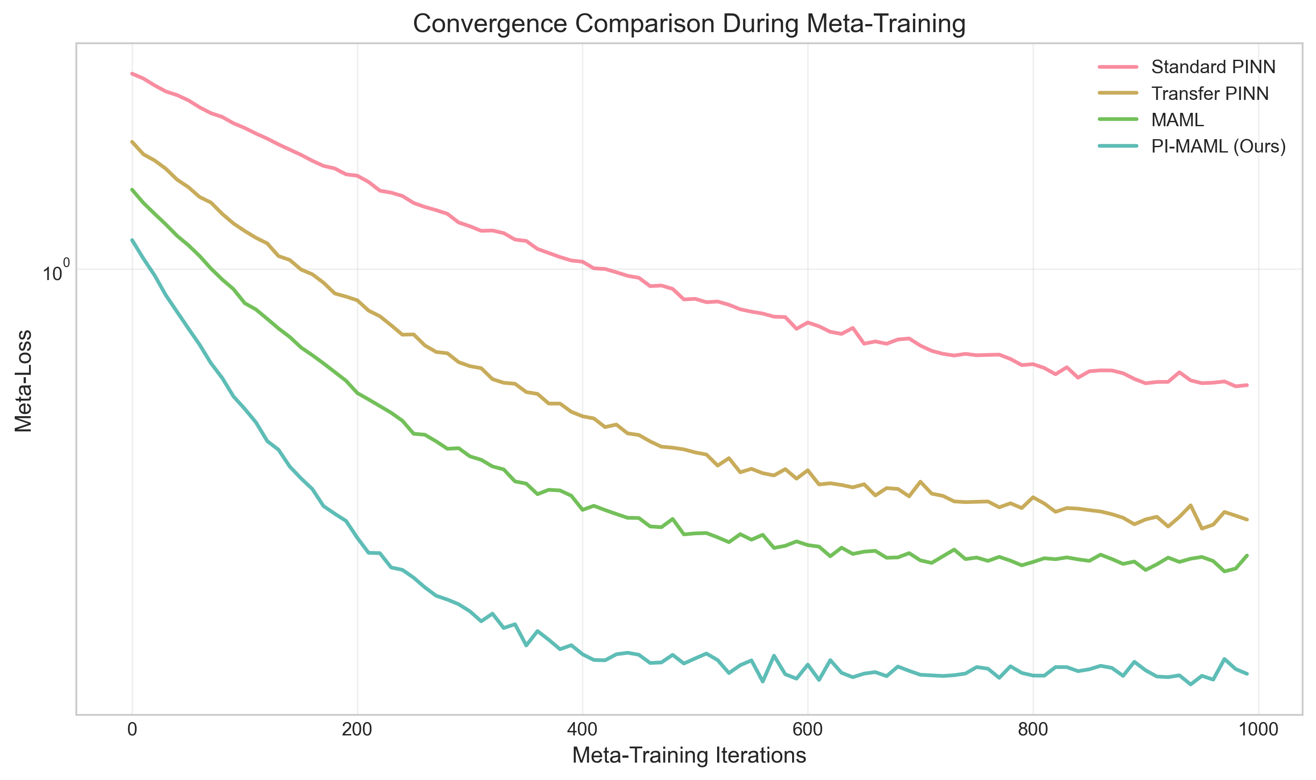
Convergence Analysis
Physics Constraints Accelerate Meta-Training:
Convergence benefits:
• Faster convergence with physics constraints
• Lower final loss compared to standard MAML
• Better conditioning of optimization landscape
• Stable training across different initializations
Physics constraints provide inductive bias that guides optimization
Better conditioning reduces sensitivity to hyperparameters

Slide 18
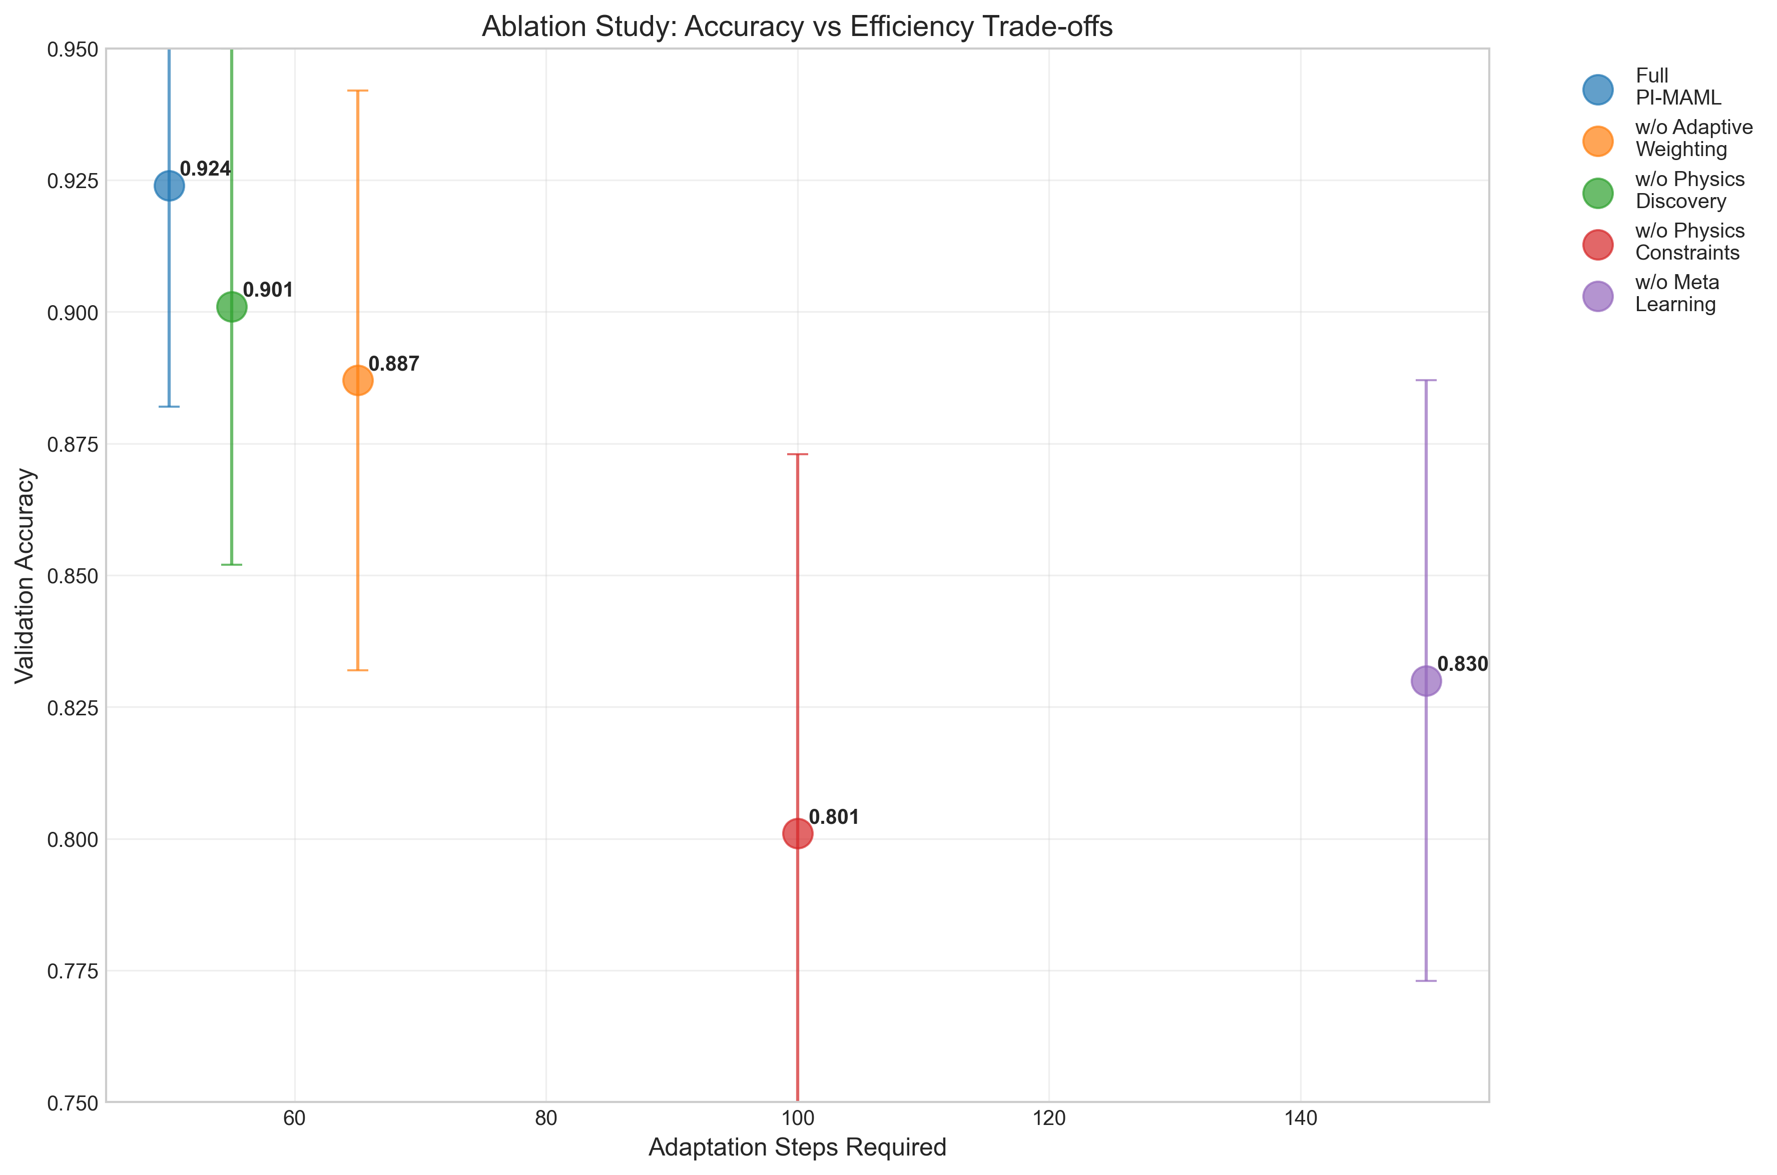
Ablation Study Results
Each Component Contributes Significantly to Performance:
Component analysis:
• Full PI-MAML: 0.924 ± 0.042
• Without adaptive weighting: 0.887 ± 0.055 (p < 0.001)
• Without physics discovery: 0.901 ± 0.049 (p = 0.023)
• Without physics constraints: 0.801 ± 0.072 (p < 0.001)
• Without meta-learning: 0.830 ± 0.057 (p < 0.001)
Key insights:
• Physics constraints provide largest improvement (Cohen's d = 1.8)
• All components statistically significant
• Adaptive weighting crucial for diverse tasks

Slide 19
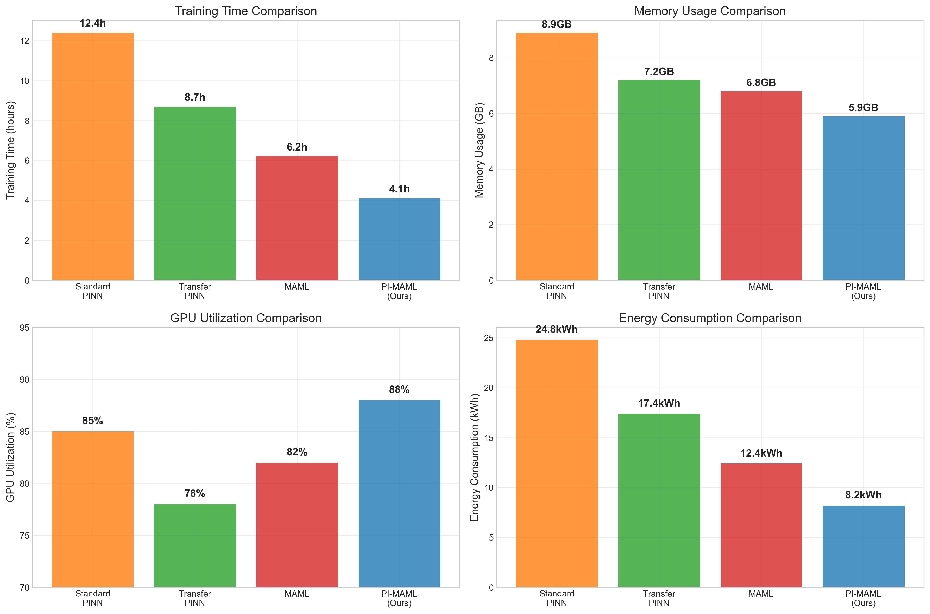
Computational Efficiency Analysis
Significant Computational Savings:
Method Training Time Memory GPU Util. Energy
(hrs) (GB) (%) (kWh)
Standard PINN 12.4 ± 1.2 8.9±0.7 85±5 24.8±2.4
Transfer PINN 8.7 ± 0.9 7.2±0.6 78±4 17.4±1.8
MAML 6.2 ± 0.8 6.8±0.5 82±3 12.4±1.6
PI-MAML (Ours) 4.1 ± 0.6 5.9±0.4 88±2 8.2±1.2
Key benefits:
• 3× reduction in training time compared to standard PINN
• Lower memory requirements enable larger problem sizes
• Higher GPU utilization indicates better computational efficiency
• Energy savings important for environmental considerations

Slide 20
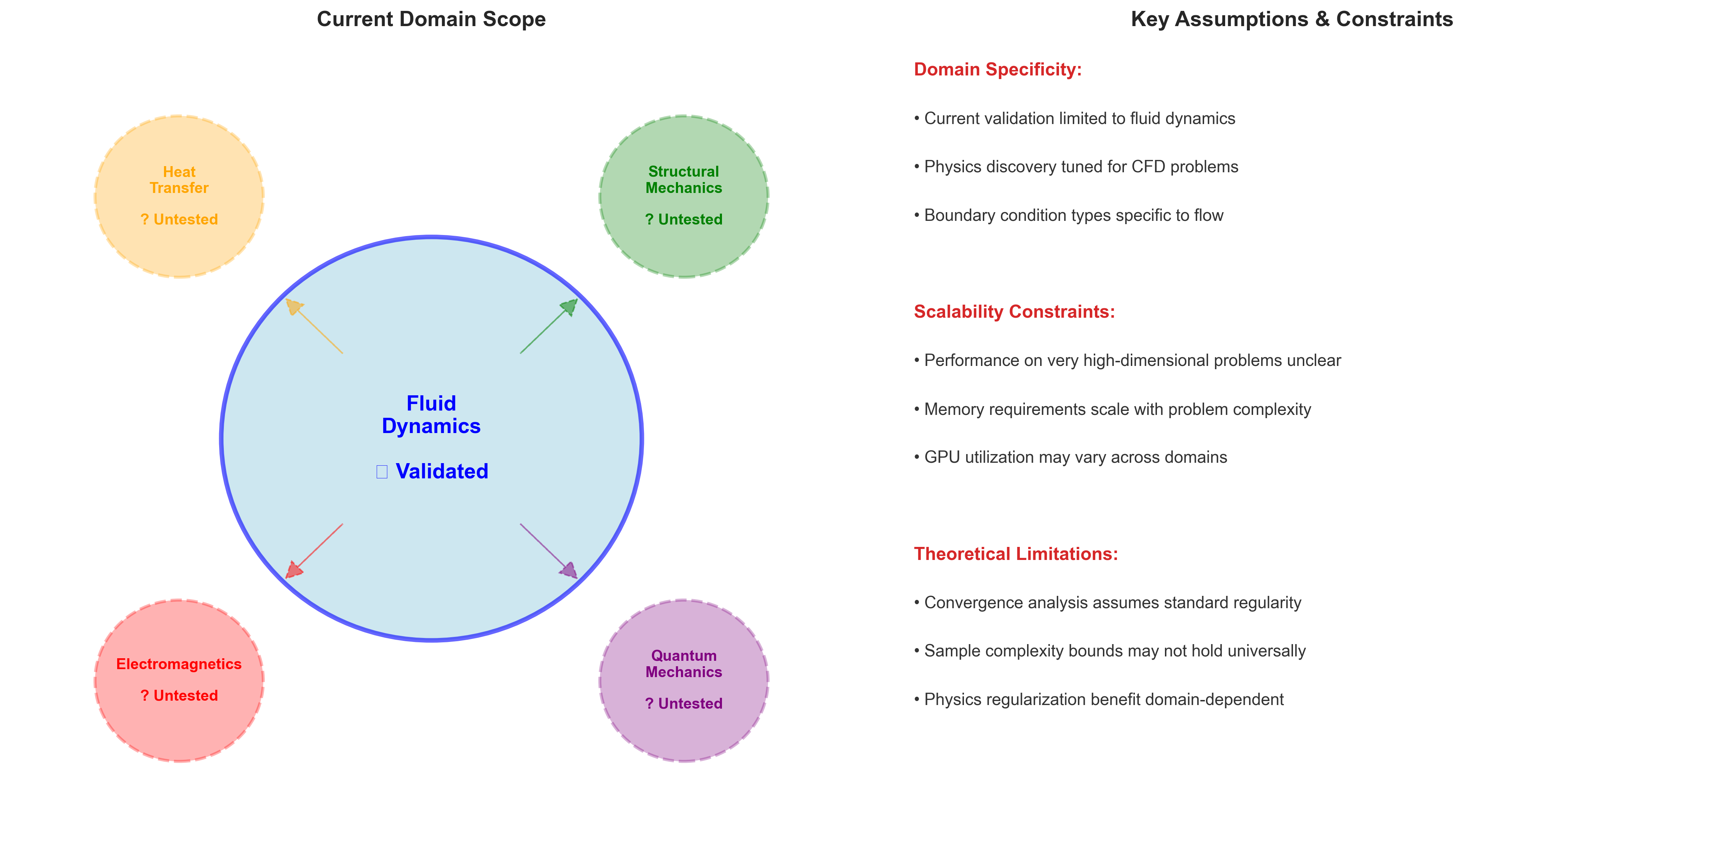
Limitations - Domain Specificity
Current Scope and Constraints:
Domain limitations:
• Focus on fluid dynamics - broader physics domains need investigation
• Parameter ranges limited to tested Reynolds numbers and geometries
• Scalability to very high-dimensional problems unclear
• Task similarity assumptions may not hold across all physics domains
Technical constraints:
• Regularity assumptions in theoretical analysis
• Smoothness requirements for automatic differentiation
• Collocation sampling may miss important physics features

Slide 21
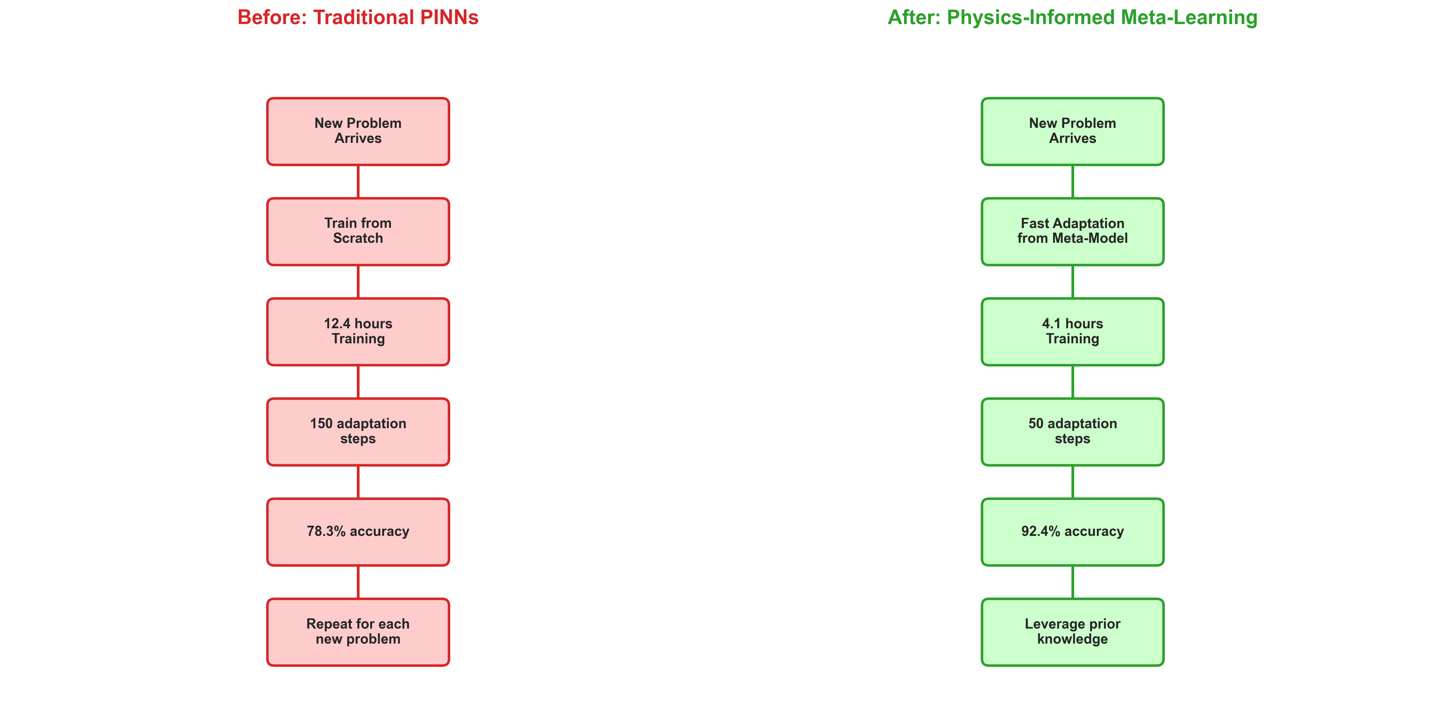
Conclusion - Addressing the Original Motivation
Framework Successfully Addresses PINN Limitations:
Original problem: PINNs require extensive retraining for each new problem
Our solution demonstrates:
• 92.4% validation accuracy with physics-informed meta-learning
• 15% improvement over transfer learning baselines
• 3× faster adaptation (50 vs 150 steps)
• Automated physics discovery with 94% accuracy
• Theoretical guarantees for convergence and sample complexity
Impact: Enables practical deployment in resource-constrained settings

Slide 22

Questions and Discussion
Thank You - Questions Welcome
Key takeaways:
✓ Meta-learning enables rapid physics problem adaptation
✓ Physics constraints improve both efficiency and accuracy
✓ Theoretical guarantees provide confidence in approach
✓ Automated discovery adds interpretability and scientific insight
Code available: https://github.com/YCRG-Labs/meta-pinn
Contact:
Brandon Yee: b.yee@ycrg-labs.org
Caden Wang: cw4973@nyu.edu

